Slide 1
CISC3024 Final Project
Classification Of SVHN Dataset With VGGNet &
Study Of Effects of Hyper-Parameters On Training And Application Performance
Huang Yanzhen, DC126732 (Presenter)
Mai Jiajun, DC127853

Slide 2
1. Intorduction
2. NN Structure
3. Experiments
1.1 Abstract
1.2 Dataset Usages
1.3 Github Page
2.1 Convolution Layers
2.2 FC Layers
3.1 Optimizer
3.2 Training Params
3.3 Augmentation Params
3.4 NN Structure
Notes:
I’ll give you an introduction to the project;

Slide 3
1. Intorduction
1.1 Abstract
1.2 Dataset Usages
1.3 Github Page

Slide 4
1. Introduction/ Abstract
What’s done in this project:
Built a Simple VGGNet (and some other extra networks)
Using the SVHN Dataset, we tested the VGGNet’s training & application performance on the following parameters.
Optimizer
Epoch Number
Learning Rate
Batch Size
Random Rotation Angle (Left + Right Boundary)
Random Crop Ratio (Left Boundary)
Contrast Factor: (Left + Right Boundary)
NN Structure

Slide 5
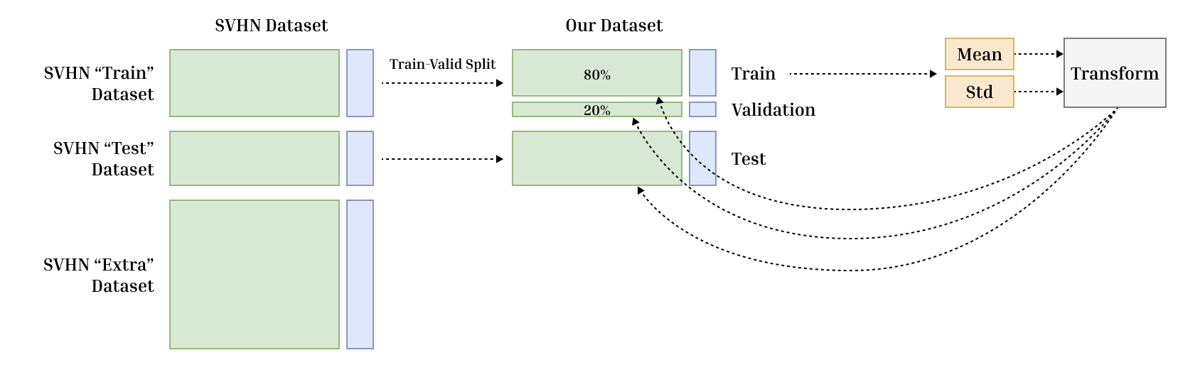
1. Introduction/ Dataset Usage
Notes:
We split 20% of validation data from the SVHN train dataset.
The remaining training data will be used to calculate Mean and Std for transform, and used for all the other datasets to prevent data leakage.

Slide 6
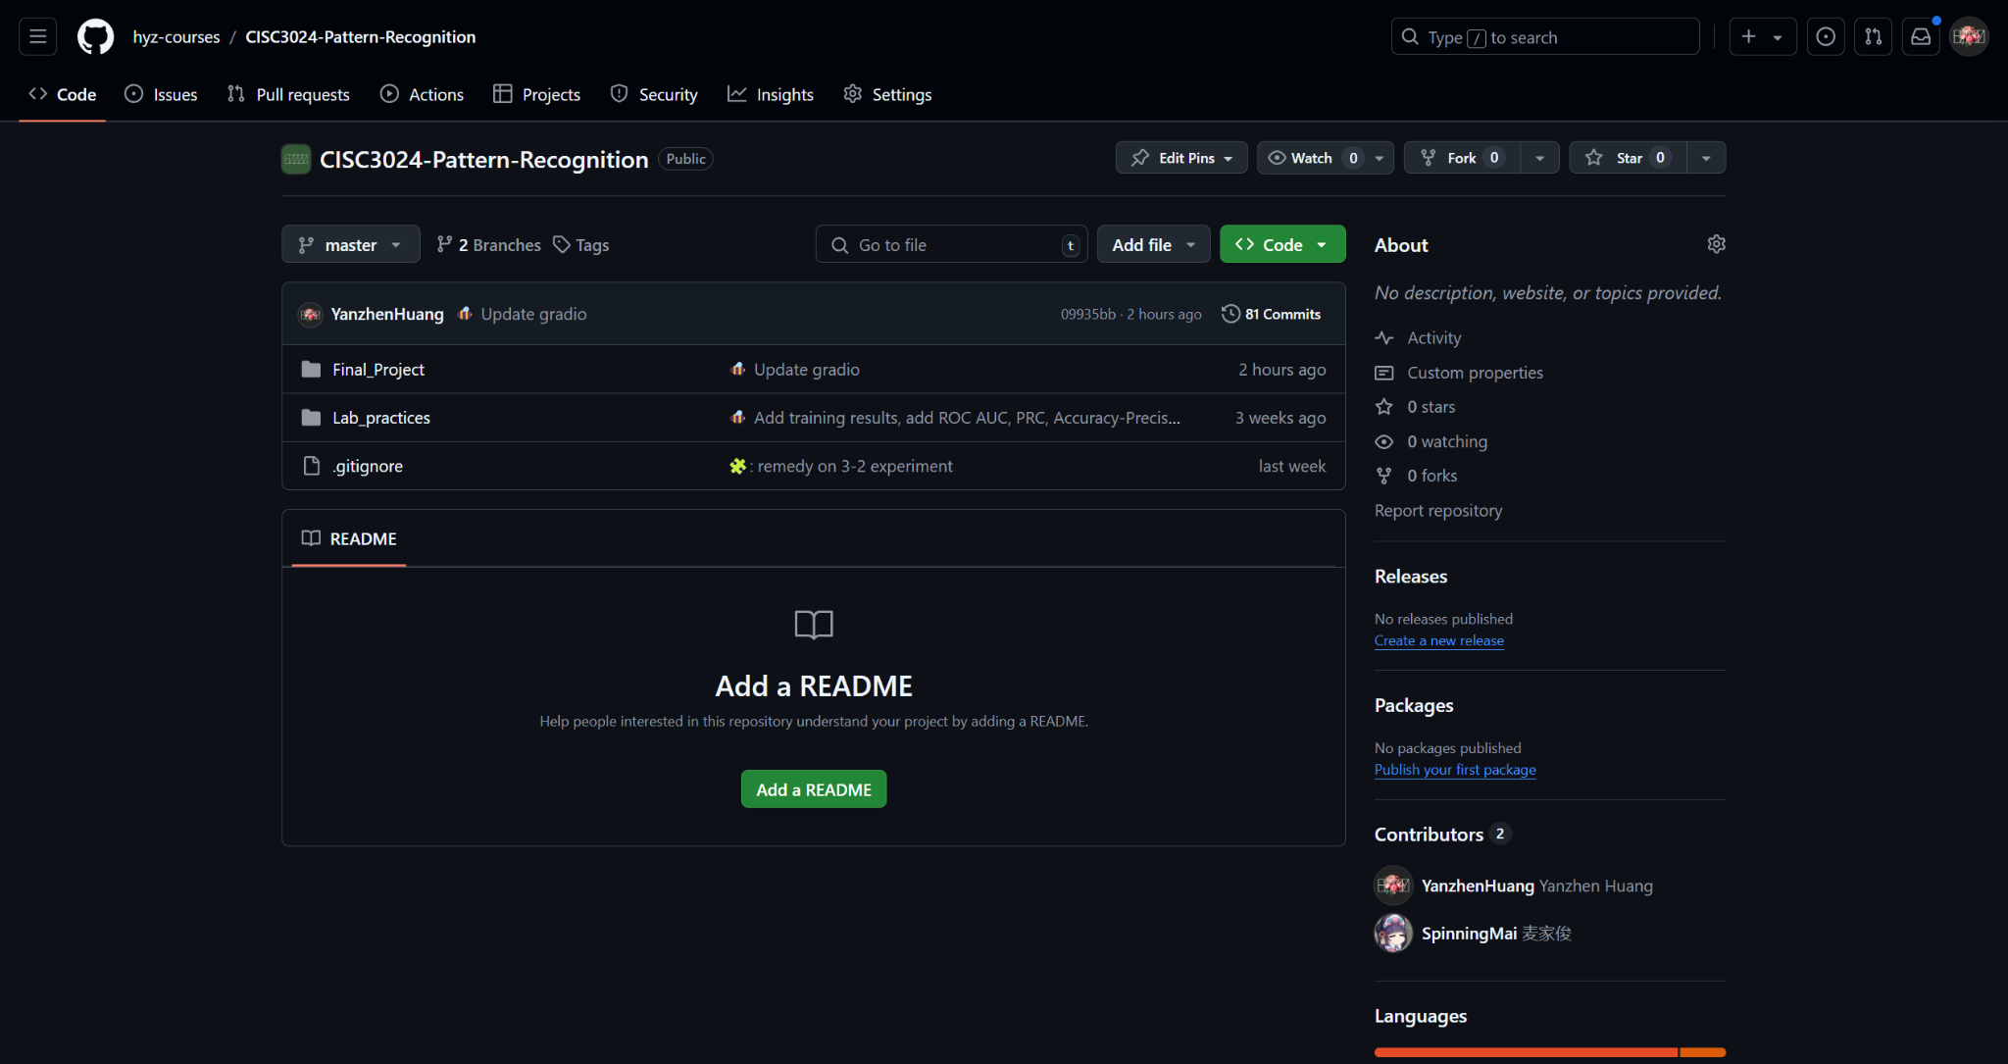

1. Introduction/ Github Repository
Repo Root: https://github.com/hyz-courses/CISC3024-Pattern-Recognition/tree/master
ipynb Source file: https://github.com/hyz-courses/CISC3024-Pattern-Recognition/blob/master/Final_Project/main.ipynb
PDF Preview: https://github.com/hyz-courses/CISC3024-Pattern-Recognition/blob/master/Final_Project/preview.html

Slide 7
2. NN Structure
2.1 Convolution Layers
2.2 FC Layers

Slide 8
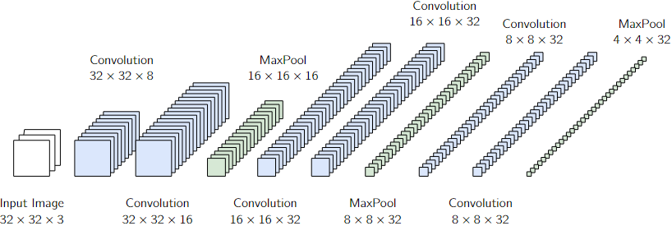
2.NN Structure / Convolution Layers
Structure of the convolution layers of the VGGNet (in AlexNet Style)
Conv_1_1
32 × 32 × 8
Conv3_1
8 × 8 × 32
Conv3_2
8 × 8 × 32
MaxPool_3
4 × 4 × 32
Conv2_1
16 × 16 × 32
Conv2_2
16 × 16 × 32
MaxPool_2
8 × 8 × 32
Input Image
32 × 32 × 3
Conv_1_2
32 × 32 × 16
MaxPool_1
16 × 16 × 16
Feature Map Column Pixels
Channels
Feature Map Row Pixels
Notes:
This is the convolution structure.
There are three convolution steps, each having two convolution layers and one maxpool layer, converting a 32x32 colored image to a feature with 512 dimensions.

Slide 9
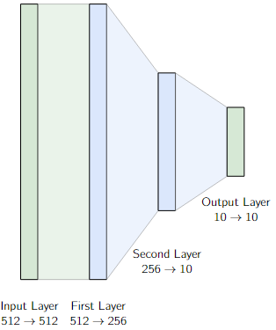
2.NN Structure / FC Layers
Structure of the fully-connected layers.
…
MaxPool_3
4 × 4 × 32
Notes:
There are two hidden layers in the fully-connected layers, mapping data from 512 to 10, which is the one-of-k result of classification.

Slide 10
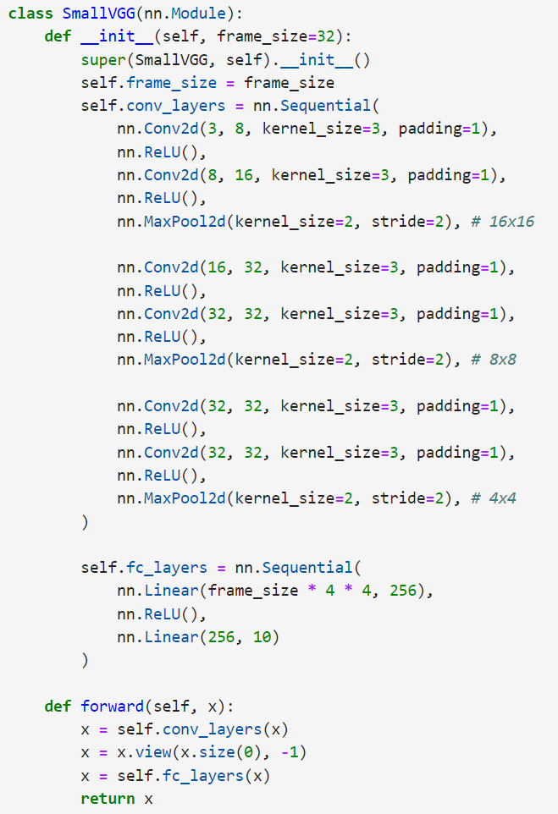
2.NN Structure / Code
Notes:
Here is the code.

Slide 11
3. Experiments
3.1 Optimizer
3.2 Training Params
3.3 Augmentation Params
3.4 NN Structure
Notes:
Next, experiments.

Slide 12
3. Experiments
Totally 7 sets of experiments:
Experiment Set 1: Optimizer
Experiment Set 2:
Training Parameters
Subset 2-1:
(Rough) Epoch Num +LR
Subset 2-2:
(Detailed) Epoch Num +LR
Experiment Set 3:
Augmentation Parameters
Subset 2-3:
Batch Size
Subset 3-1:
Rotation Angles &
Crop Percentages
Subset 3-1:
Aspect Ratios &
Contrast Factors
Experiment Set 4:
Extra: Different NNs + Activation Functions
Notes:
There are 7 experiments. We’ll test the optimizers, several training parameters, several augmentation parameters, and lastly different types of networks.

Slide 13
3. Experiments / Experiment Set 1: Optimizer
Parameters
Optimizer: [Adam, SGD, RMSprop, AdamW, Adagrad, SGD+Nesterov]
Epoch: 15
LR: 1e-3
Batch Size: 128
Angle: 0
Crop: 0
Ratio: 1
Contrast Factor: 1
Loss Function: Cross Entropy Loss

Slide 14
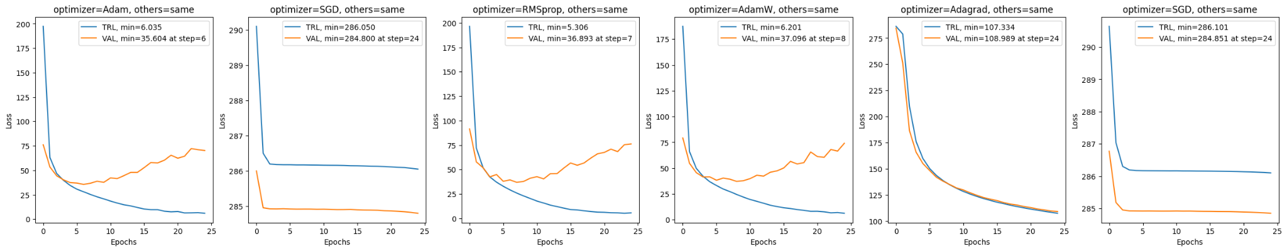
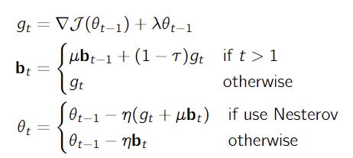
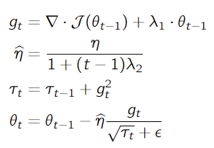
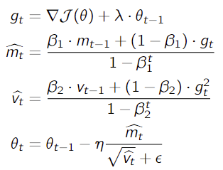
3. Experiments / Experiment Set 1: Optimizer
Adam
SGD
RMSprop
AdamW
Adagrad
SGD (Nesterov)
SGD Family
Adagrad
RMSprop Family
Require Proper Initialization of momentum
Monotonical decrease of learning rate
curve gets smoother
Weighted avg of squared gradient
With a “forgetting” factor
Notes:
The tested optimizers can be categorized into three families: SGD, Adagrad and RMSprop.
SGD needs proper initialization of momentum, otherwise their performance will be very bad.
Adagrad has monotonical decrease of learning rate & momentum so they have smoother curve and slower convergence.
And RMSprop uses the forgetting factor beta to re-boost the momentum.
The best ones are the RMSprop family, especially Adam.

Slide 15
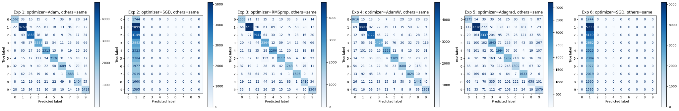
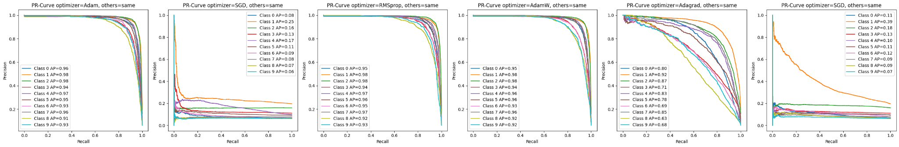
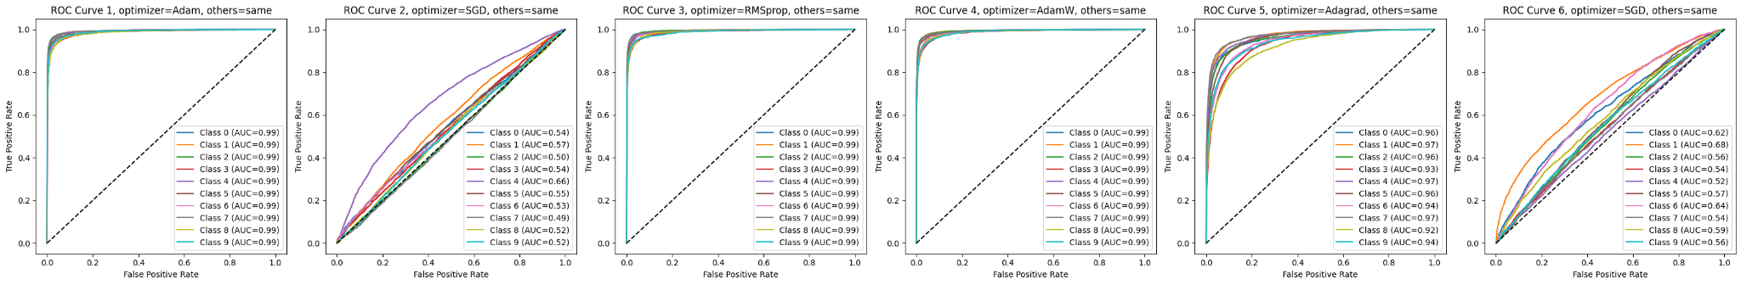
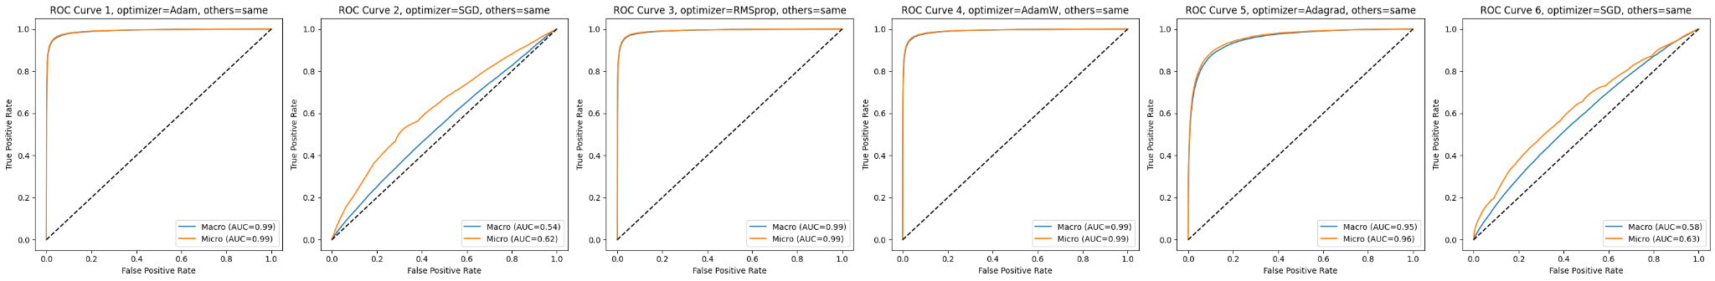
3. Experiments / Experiment Set 1: Optimizer
Adam
SGD
RMSprop
AdamW
Adagrad
SGD (Nesterov)
Confusion Matrix
Precision-Recall Curve
ROC All
Macro & Micro ROC
Notes:
Here, you can have a look a the overall performance.

Slide 16
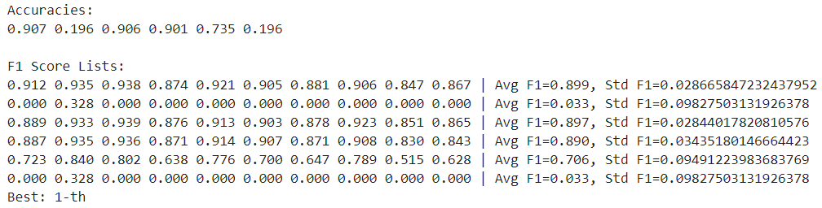
3. Experiments / Experiment Set 1: Optimizer
Evaluation Metrics
RMSprop family performs the best, Adagrad the second, SGD family the worst.
Notes:
The Adam is the best with the highest accuracies and avg F1 score.

Slide 17
3. Experiments / Experiment Set 2: Training Params
Subset 2-1: (Rough Search) Epoch Number & LR
Parameters
Optimizer: Adam
Epoch: [10, 15, 20, 25]
LR: [1e-3, 1e-4, 1e-5, 1e-6]
Batch Size: 128
Angle: 0
Crop: 0
Ratio: 1
Contrast Factor: 1
Loss Function: Cross Entropy Loss
Notes:
Next, epoch and learning rate.

Slide 18
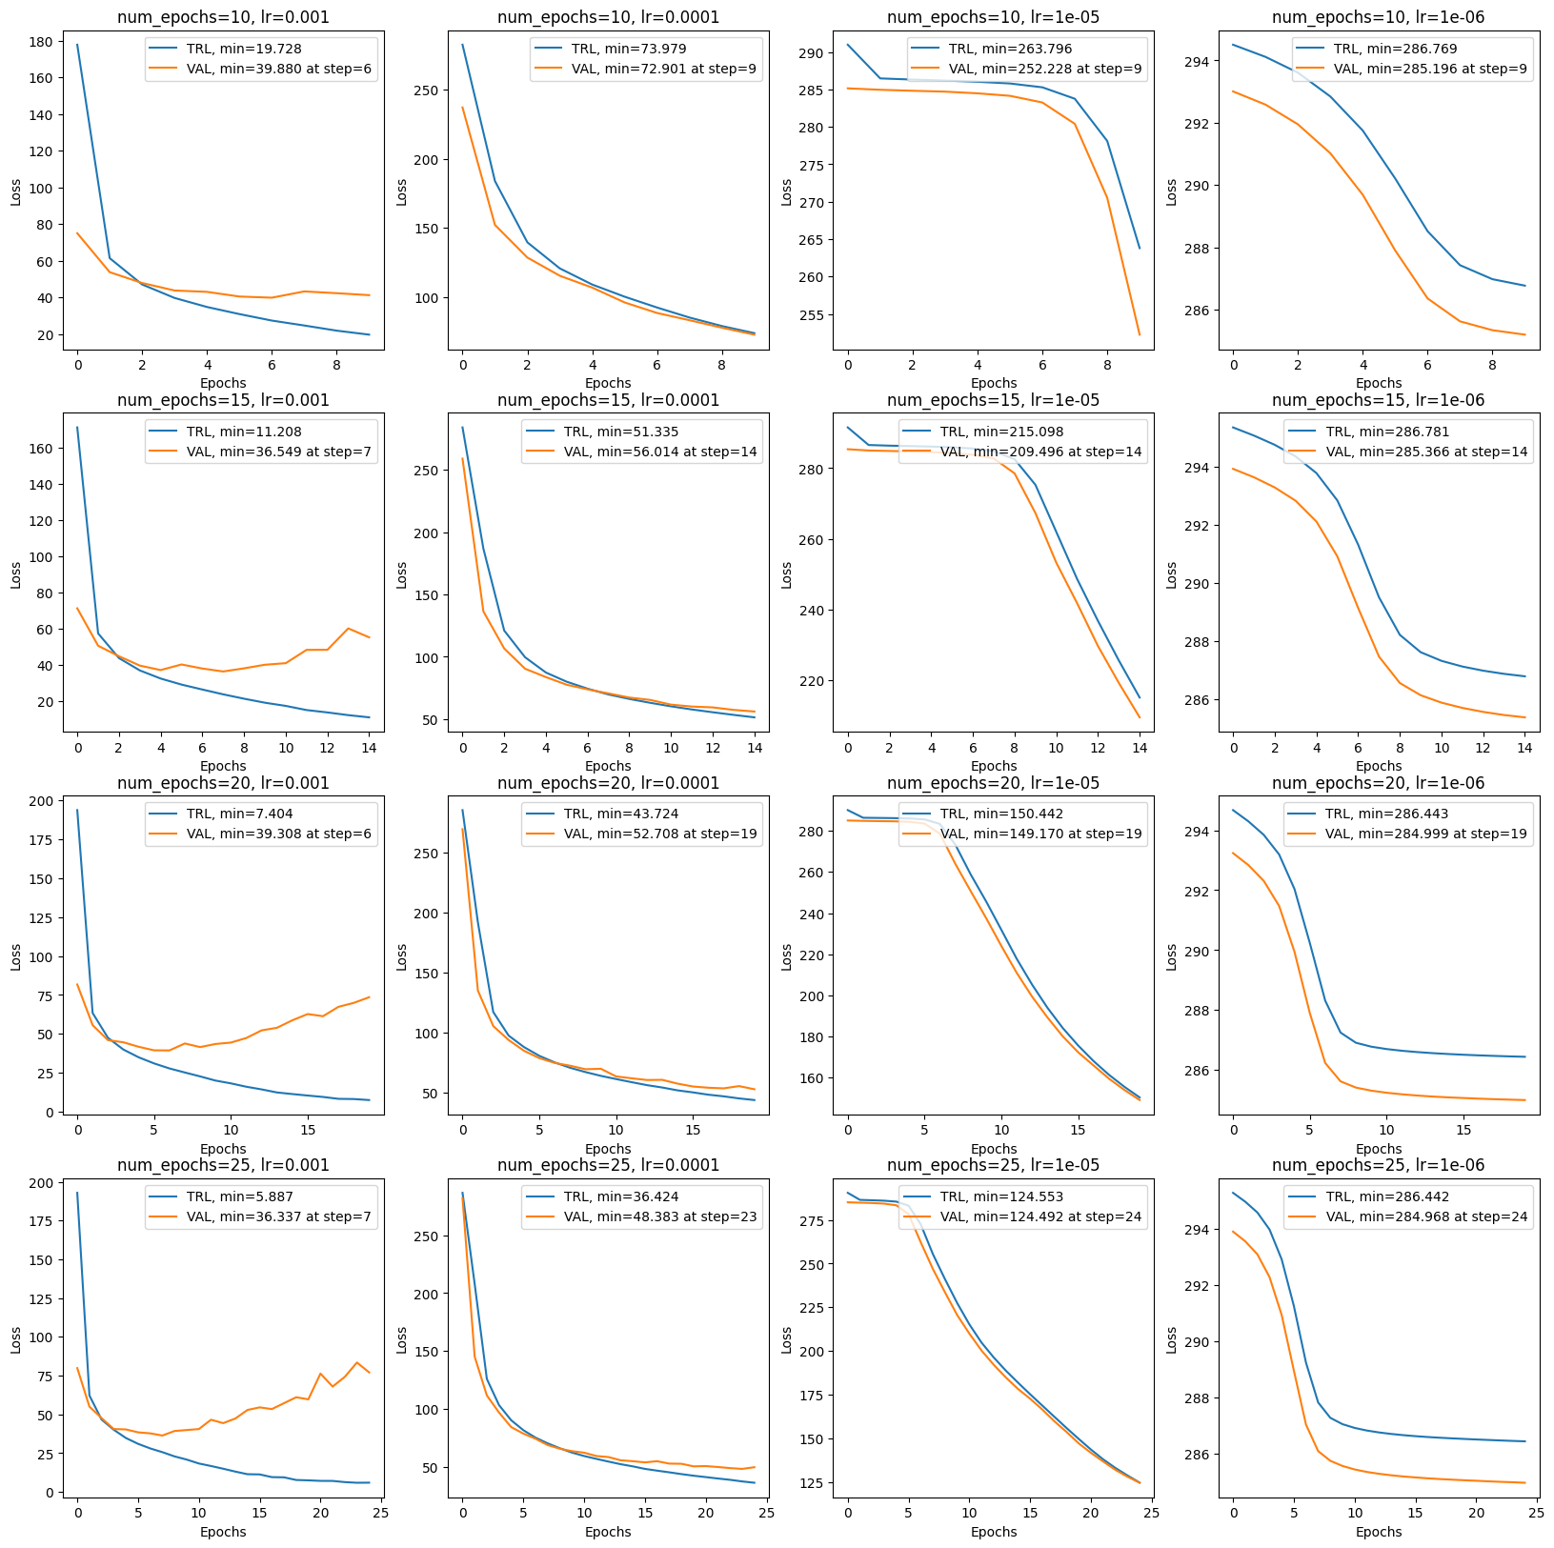
3. Experiments / Experiment Set 2: Training Params
Subset 2-1: (Rough Search) Epoch Number & LR
Epoch-Loss Curves
The effect of epoch is weaker than the effect of learning rate.
Left to Right columns: LR decreases
1e-3: Quickly converges and over-fits, potentially jump over local minimum.
1e-4: Converge slowlier
1e-5: LR low enough that Adam can’t counter its effect.
1e-6: LR too low, potential gradient vanishing.
Fairly good local minimums:
36.549 at num_epochs=15 & LR=1e-3, over-fit point=7
36.337 at num_epochs=25 & LR=1e-3m; over-fit point=7
lr=1e-3
lr=1e-4
lr=1e-5
lr=1e-6
num_epochs=10
num_epochs=15
num_epochs=20
num_epochs=25
Notes:
Epoch number controls the training progress, and the learning rate controls the training pace.
From left to right columns, LR decreases exponentially, and the convergence speed gets slower. And we have fairly good local minimums at around 36.

Slide 19
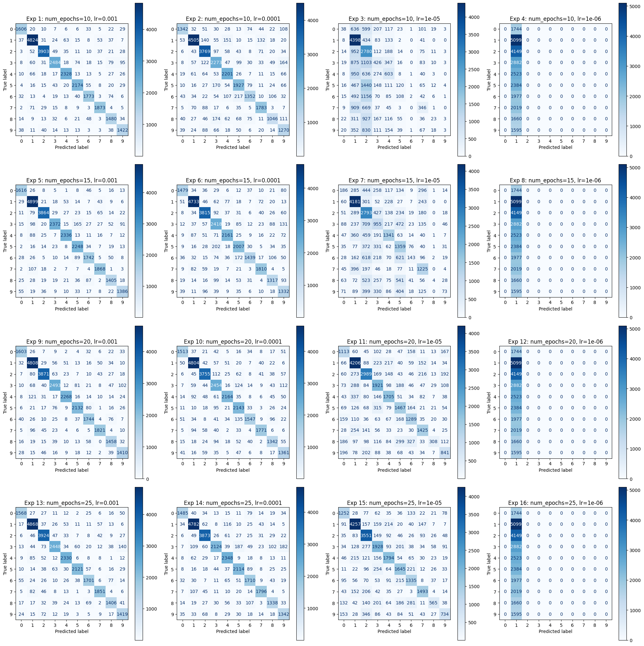
3. Experiments / Experiment Set 2: Training Params
Subset 2-1: (Rough Search) Epoch Number & LR
Confusion Matrices
Left to Right columns, matrices gets “blurrer”.
LR=1e-6 does not provide any useful model. Don’t fit at all.
lr=1e-3
lr=1e-4
lr=1e-5
lr=1e-6
num_epochs=10
num_epochs=15
num_epochs=20
num_epochs=25
Notes:
From left to right, as model gets less fitted better, the matrices gets blurrer. The learning rate of 1e-6 didn’t learn anything.

Slide 20
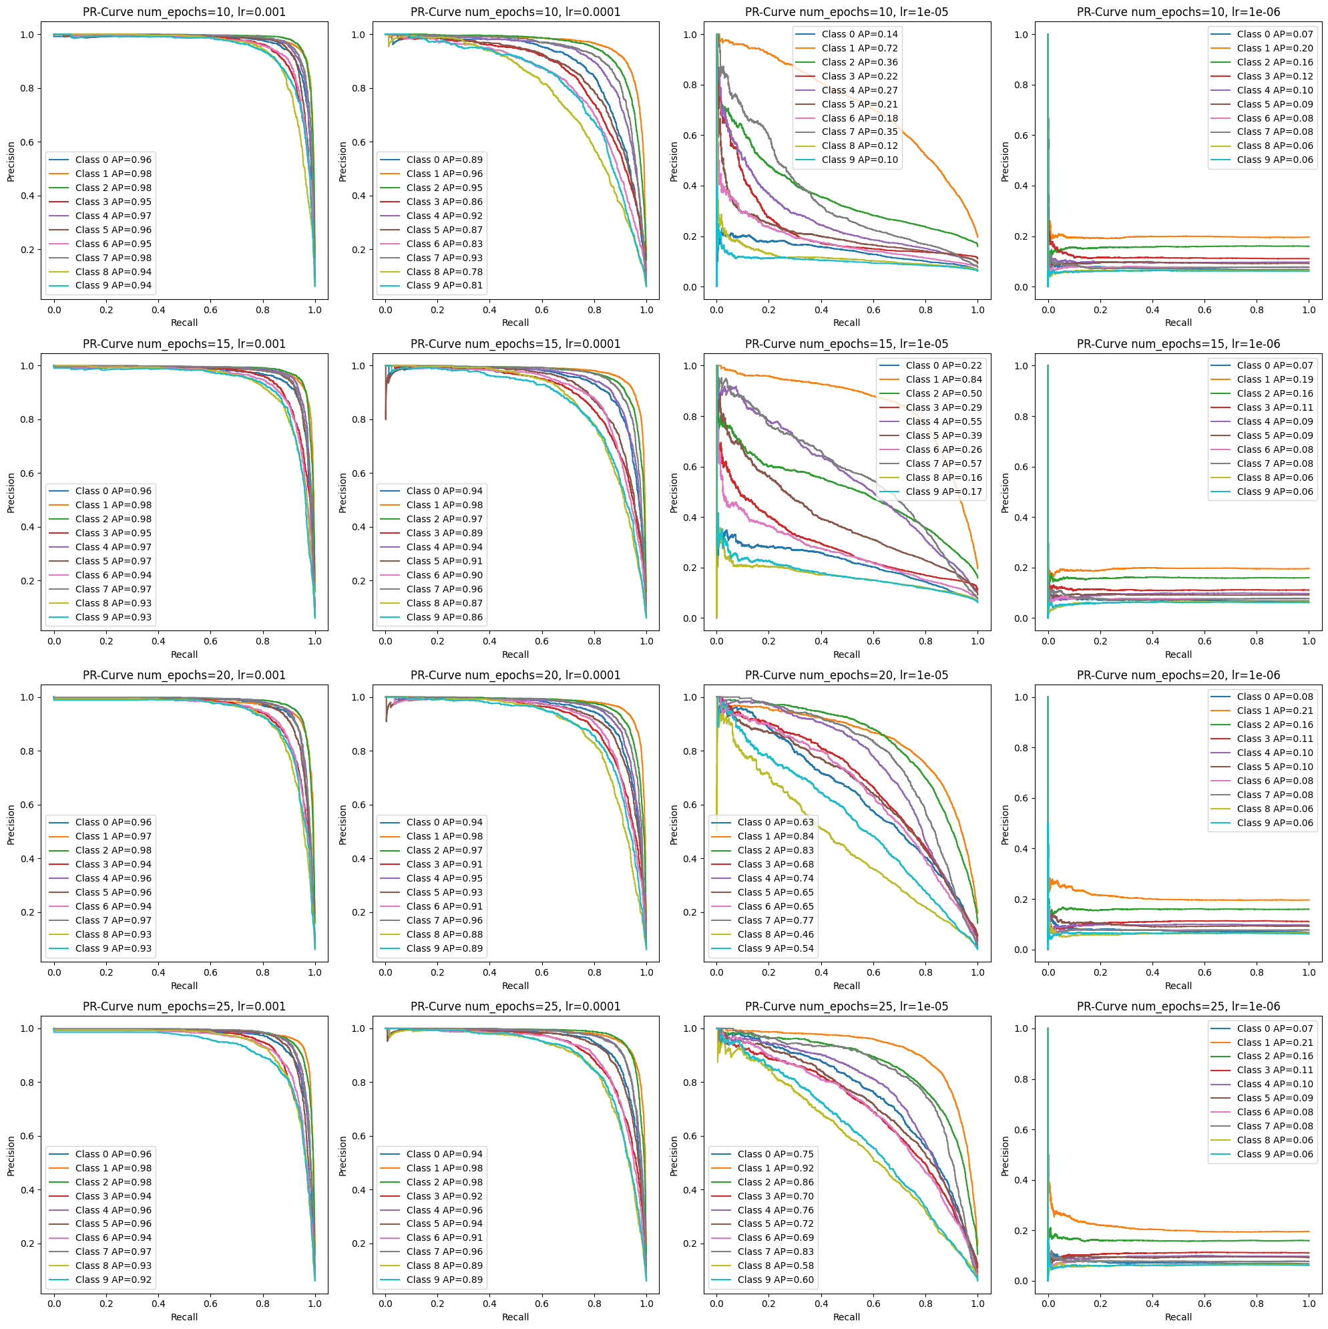
3. Experiments / Experiment Set 2: Training Params
Subset 2-1: (Rough Search) Epoch Number & LR
Precision Recall Curve
The curve tends from the top-right to the bottom left as LR decreases exponentially.
LR=1e-3 & LR=1e-4, epoch plays a weak role due to fast convergence.
LR=1e-5, AP is sensitive to epoch number due to slow convergence.
epoch_num=10, AP~0.1
epoch_num=15, AP~0.2
epoch_num=20, AP~0.5
epoch_num=25, AP~0.8
LR=1e-6, PR curves are corrupted (divide-zero). Epoch number has no effect due to non-convergence.
lr=1e-3
lr=1e-4
lr=1e-5
lr=1e-6
num_epochs=10
num_epochs=15
num_epochs=20
num_epochs=25
Notes:
I want to address the sensitivity of LR=1e-5 on epochs.

Slide 21
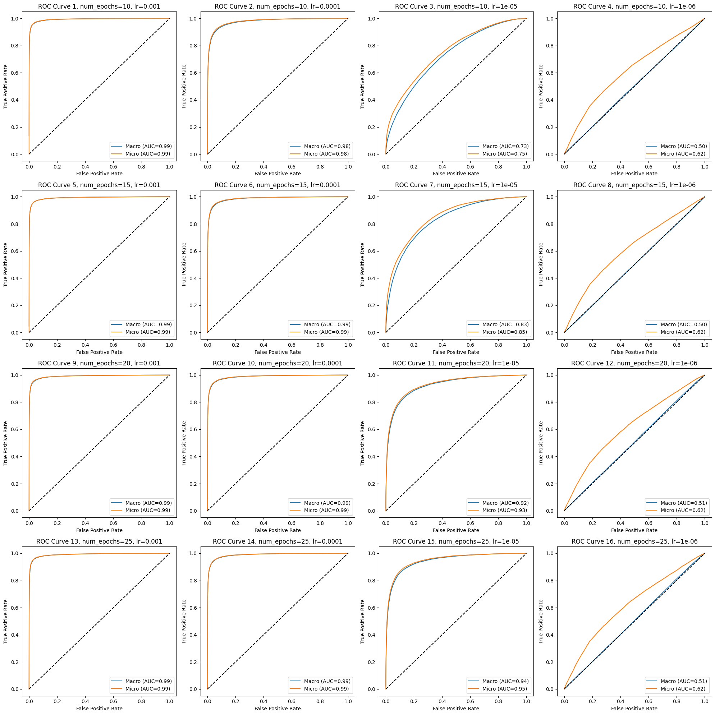
3. Experiments / Experiment Set 2: Training Params
Subset 2-1: (Rough Search) Epoch Number & LR
Macro & Micro ROC Curve
Good performance: LR=1e-3 & LR=1e-4, with ROC-AUC curves of ~0.99.
Fair performance: LR=1e-5, performance grows as epoch number grows.
Worst performance: Macro ROC curve over-laps with the random-split diagonal line. Difference between the Micro and Macro curve is huge, unbalance performance in label.
lr=1e-3
lr=1e-4
lr=1e-5
lr=1e-6
num_epochs=10
num_epochs=15
num_epochs=20
num_epochs=25
Notes:
The sensitivity could still be witnessed here.
For 1e-6, the performance on different classes is imbalanced so the two scores has big difference.

Slide 22
3. Experiments / Experiment Set 2: Training Params
Subset 2-2: (Detailed Search) Epoch Number & LR
Parameters
Optimizer: Adam
Epoch: 15
LR: geomspace(1e-4, 5e-3, 8)
Batch Size: 128
Angle: 0
Crop: 0
Ratio: 1
Contrast Factor: 1
Loss Function: Cross Entropy Loss
Notes:
To make sure no obvious local minimum is ignored, we performed a detailed search.

Slide 23
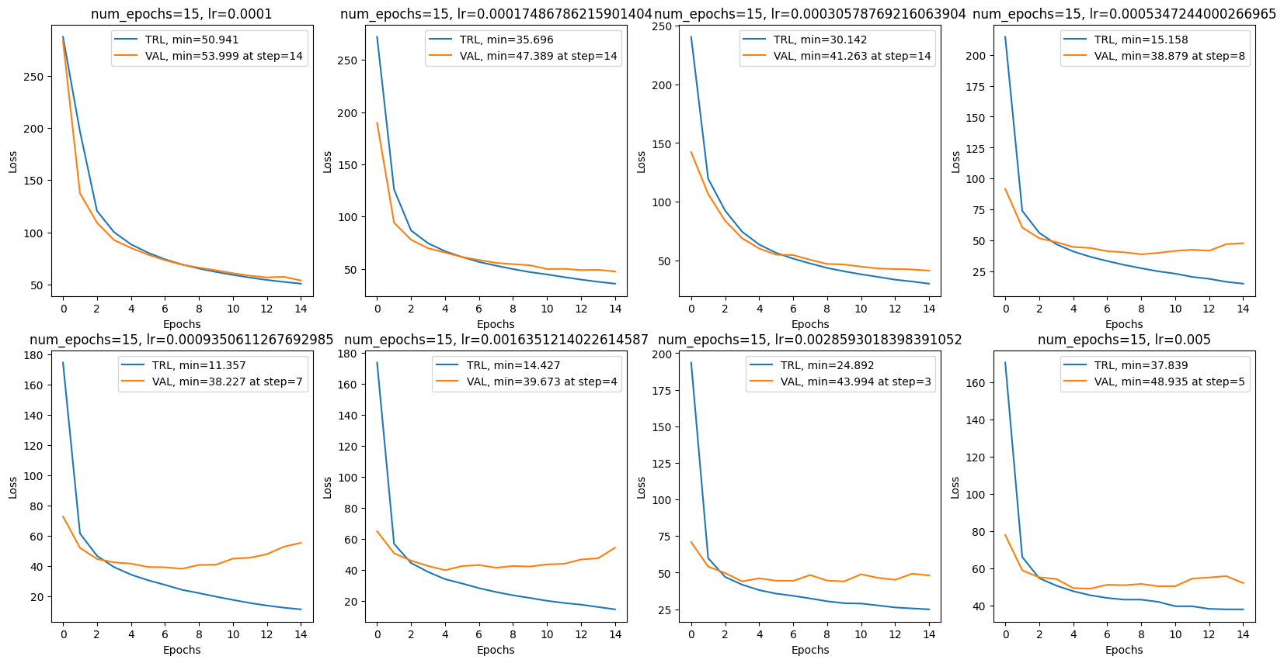
3. Experiments / Experiment Set 2: Training Params
Subset 2-2: (Detailed Search) Epoch Number & LR
Epoch-Loss Curves
Attempt to find a missing local minimum, but didn’t find one within the given range of LR.
Best min validation loss 38.227 from num_epochs=15 & LR=0.000935=9.35e-4.
Still larger than 36.549 from num_epochs=15 & LR=1e-3
Notes:
We searched around the previous optimum learning rate 1e-3, but the optimal here is inferior.

Slide 24
3. Experiments / Experiment Set 2: Training Params
Subset 2-3: Batch Size
Parameters
Optimizer: Adam
Epoch: Determined by the early-stop mechanism.
LR: geomspace(1e-4, 5e-3, 8)
Batch Size: [16, 32, 64, 128]
Angle: 0
Crop: 0
Ratio: 1
Contrast Factor: 1
Loss Function: Cross Entropy Loss
Notes:
Next, Batch Size.

Slide 25
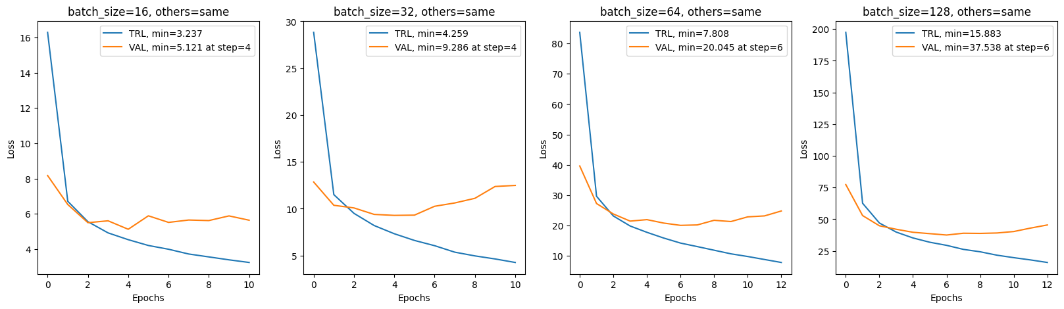
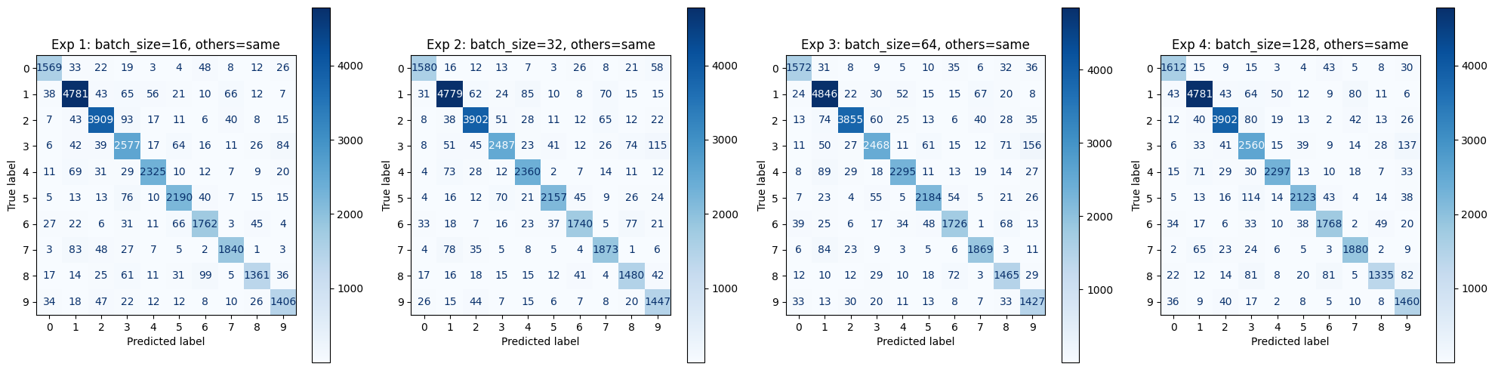
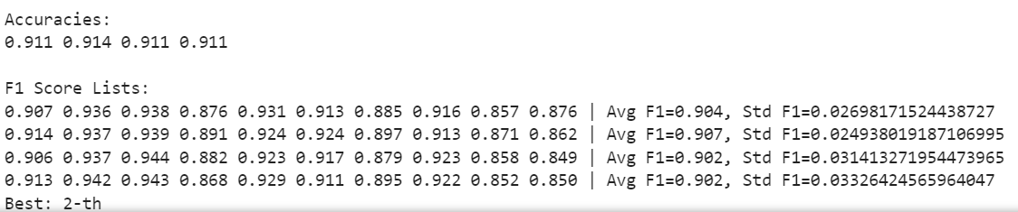
3. Experiments / Experiment Set 2: Training Params
Subset 2-3: Batch Size
Epoch-Loss Curves
Batch size doesn’t affect the model training performance significantly.
Calculate the minimum loss with ratios: loss/batch_size, all around 0.2~0.3.
Confusion Matrix
No visual difference, all have a clear counter-diagonal line.
Evaluation Metrics
The accuracies and F1 scores are roughly identical for all the batch sizes.
0.3125
0.21825
0.3125
0.296875
Notes:
Batch size doesn’t affect the model training performance significantly.
If we calculate the loss correctly you will find it identical. The other evaluation metrics tell the same story.

Slide 26
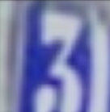
3. Experiments / Experiment Set 3: Augmentation Parameters
Subset 3-1: Angle & Crop
Parameters
Optimizer: Adam
Epoch: Determined by the early-stop mechanism.
LR: 1e-3
Batch Size: 128
Angle: [15, 30, 45, 60]
Crop: [0.08 (Default), 0.24, 0.4, 0.6]
Ratio: 1
Contrast Factor: 1
Loss Function: Cross Entropy Loss
Original
Random Rotation
Random Crop

Slide 27
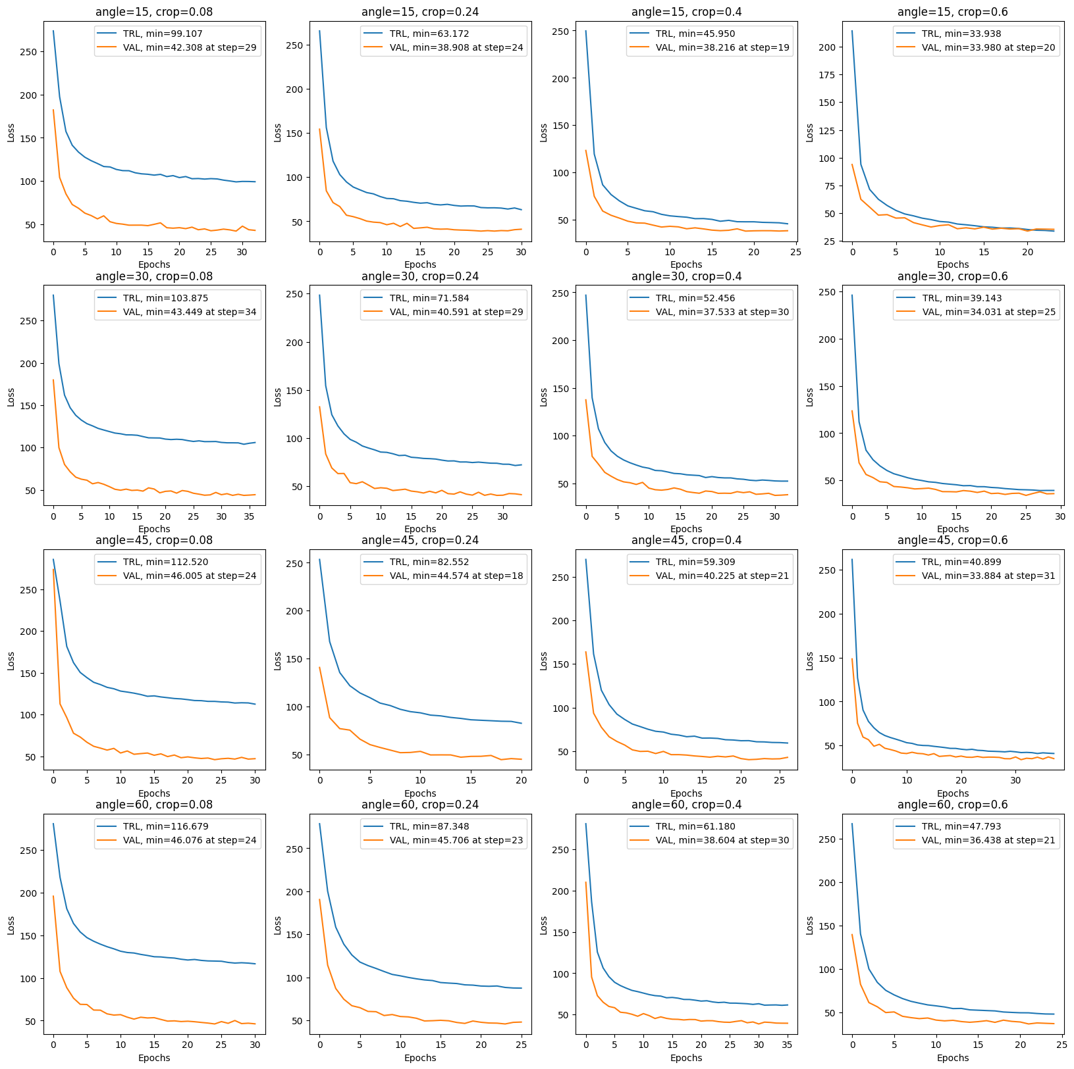
3. Experiments / Experiment Set 3: Augmentation Parameters
Subset 3-1: Angle & Crop
Epoch-Loss Curves
Lowest validation loss: 33.884
at angle=45, crop=0.6
better than 36.337, where augmentation is not given.
Crop increase, initial validation loss decrease.
Easier challenge for the model.
Angle=60 meets an increase in training loss.
If the angle is to big, it may mess up some data. e.g., Problem with angle=60: Mess up “6” and “9”
crop=0.08
crop=0.24
crop=0.4
crop=0.6
angle=15
angle=30
angle=45
angle=60
Notes:
Optimal at angle limit 45 and crop percentage 0.6, minimum validation loss lower than the one without augmentation.
Crop increase, initial validation loss decrease.
Angle too small, no data variety. Angle too big, mess with data.
Angle=60 meets an increase in training loss, since 6 and 9 will be mixed together.

Slide 28
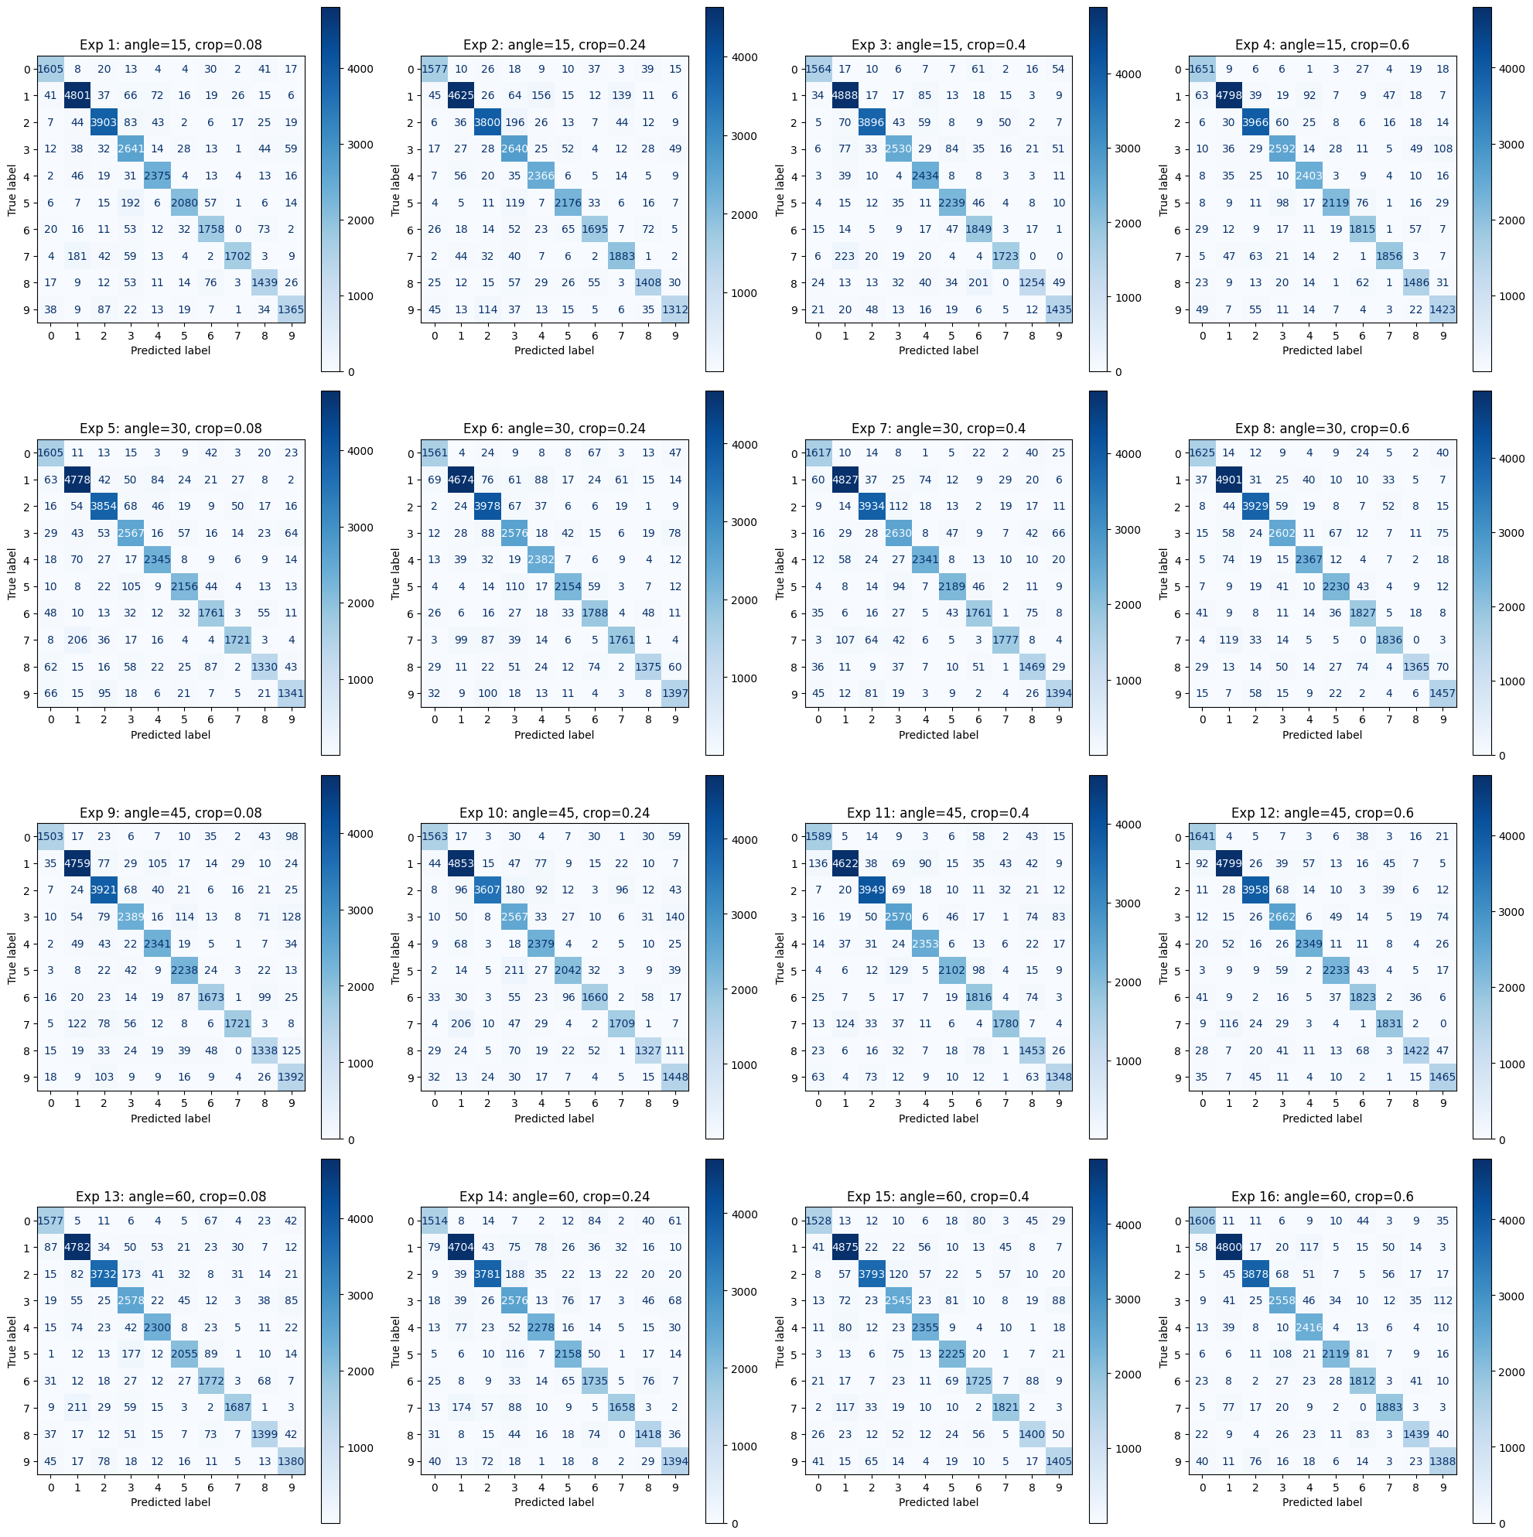
3. Experiments / Experiment Set 3: Augmentation Parameters
Subset 3-1: Angle & Crop
Confusion Matrices:
No obvious visual difference.
All experiments gives a clear counter-diagonal line.
crop=0.08
crop=0.24
crop=0.4
crop=0.6
angle=15
angle=30
angle=45
angle=60

Slide 29
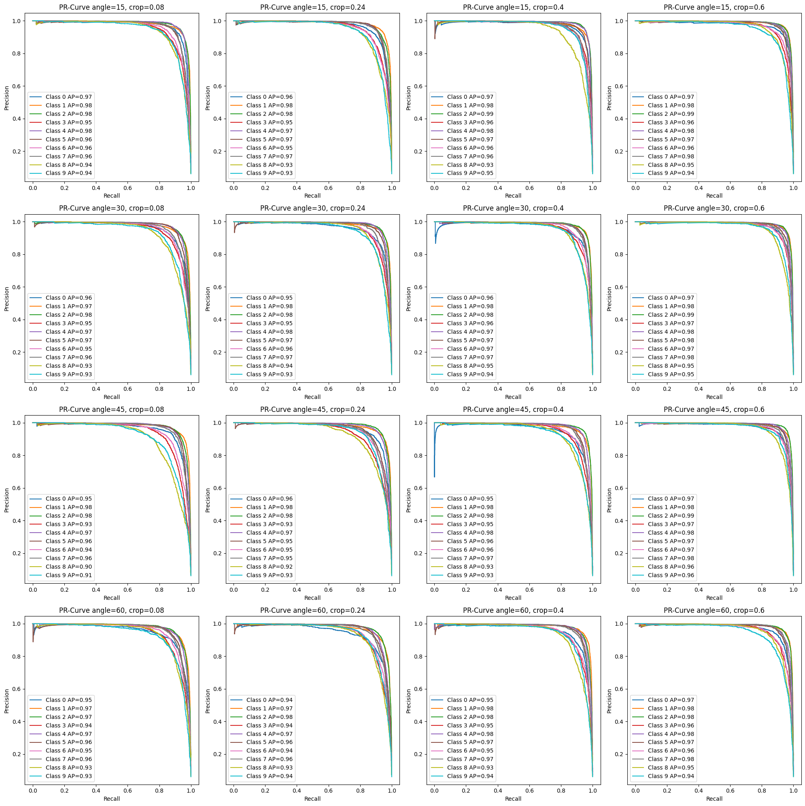
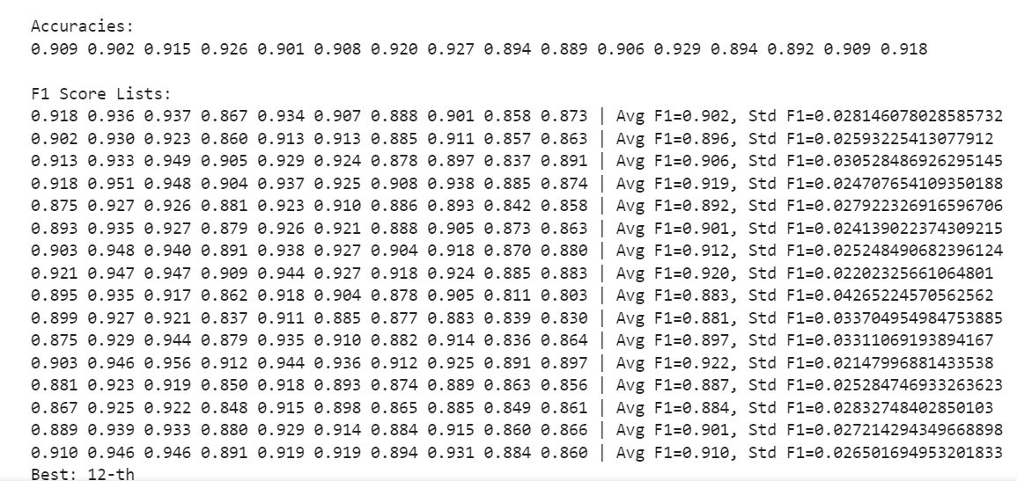
3. Experiments / Experiment Set 3: Augmentation Parameters
Subset 3-1: Angle & Crop
Precision-Recall Curves
No obvious visual difference.
All the combinations produced a class-wise average precision score of around 0.95.
The 12-th one has the best accuracy of 0.929, with also the highest Avg F1 score of 0.922. (Consistent with Epoch-Loss curve)
crop=0.08
crop=0.24
crop=0.4
crop=0.6
angle=15
angle=30
angle=45
angle=60
Notes:
All the combinations produced a class-wise average precision score of around 0.95, with the 12-th being the optimal.

Slide 30
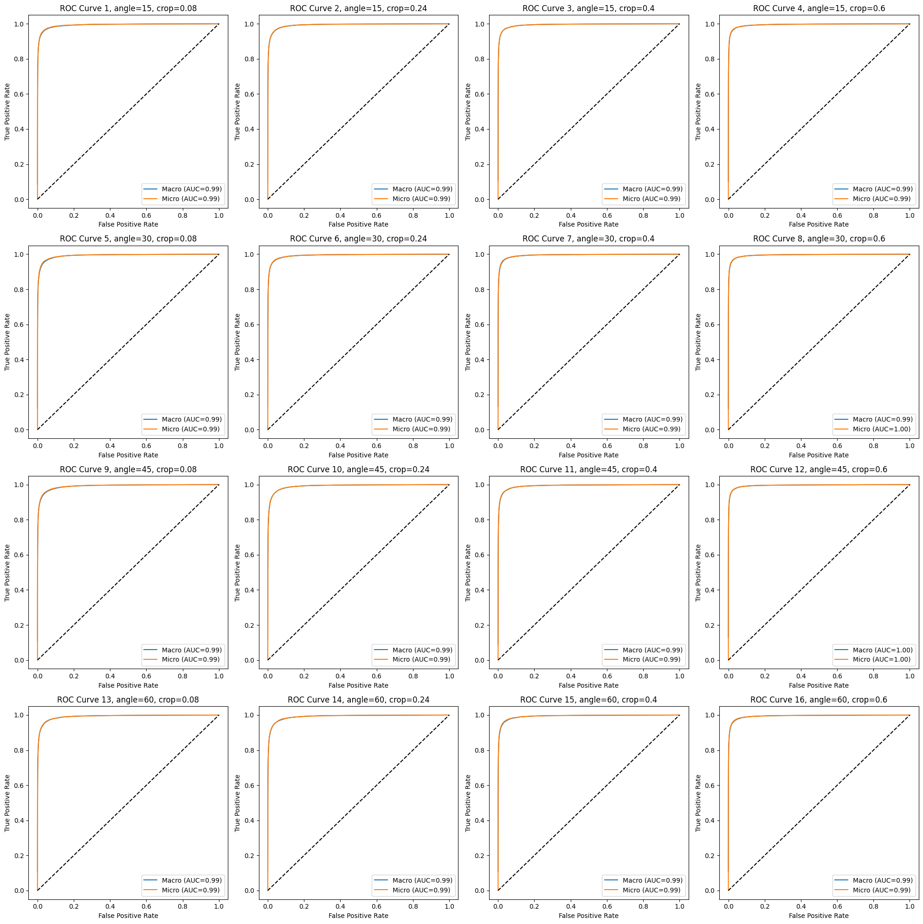
3. Experiments / Experiment Set 3: Augmentation Parameters
Subset 3-1: Angle & Crop
Macro & Micro ROC Curves
No obvious visual difference.
All the macro & micro ROC-AUC scores are above 0.99.
The optimum suggested by the epoch-loss curve (angle=45 & crop=0.6) gives an ROC-AUC score of nearly 1.00.
Better than the others.
crop=0.08
crop=0.24
crop=0.4
crop=0.6
angle=15
angle=30
angle=45
angle=60

Slide 31
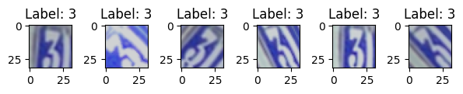
3. Experiments / Experiment Set 3: Augmentation Parameters
Subset 3-2: AspRatios & Contrast
Parameters
Optimizer: Adam
Epoch: Determined by early-stopping mechanism.
LR: 1e-3
Batch Size: 128
Angle: 45
Crop: 0.6
Ratio: [0.25, 0.42, 0.58, 0.75]
Contrast Factor: [1.2, 1.4, 1.6, 1.8]
Loss Function: Cross Entropy Loss
Original
Aspect Ratios
Contrast

Slide 32
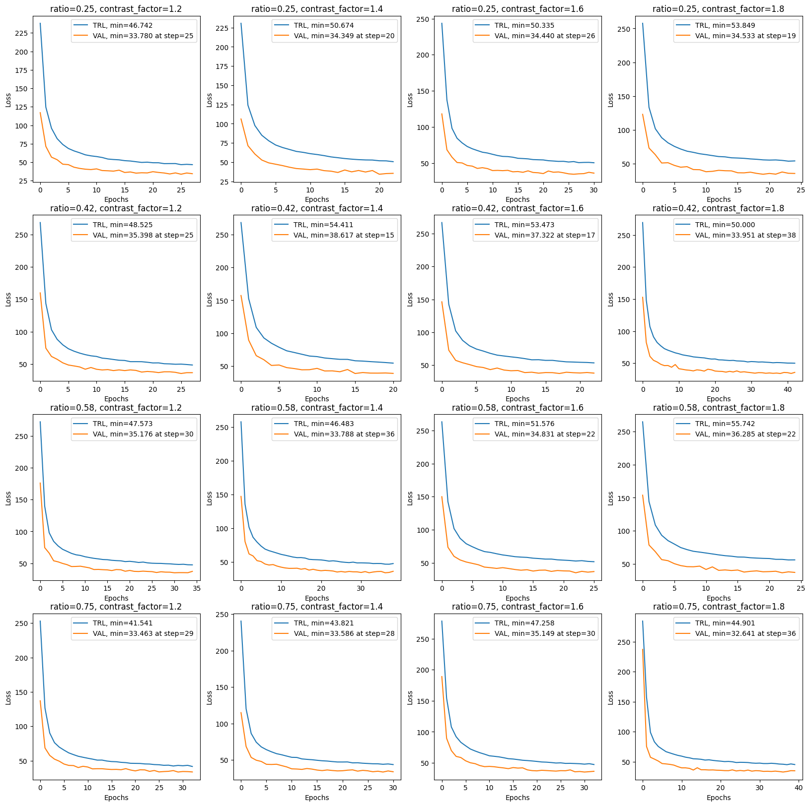
3. Experiments / Experiment Set 3: Augmentation Parameters
Subset 3-2: AspRatios & Contrast
Epoch-Loss Curves
Lowest validation loss: 32.641
at ratio=0.75, contrast_factor=1.8
Generally no big difference in lowest validation loss.
Ratio increase, initial validation loss increase.
The 16-th model here is the optimal by far.
cf=1.2
cf=1.4
cf=1.6
cf=1.8
ratio=0.25
ratio=0.42
ratio=0.58
ratio=0.75
Notes:
Ratio increase, initial validation loss increase.
Higher, contrast factor, the better the model.
The 16-th model here is the optimal by far.

Slide 33
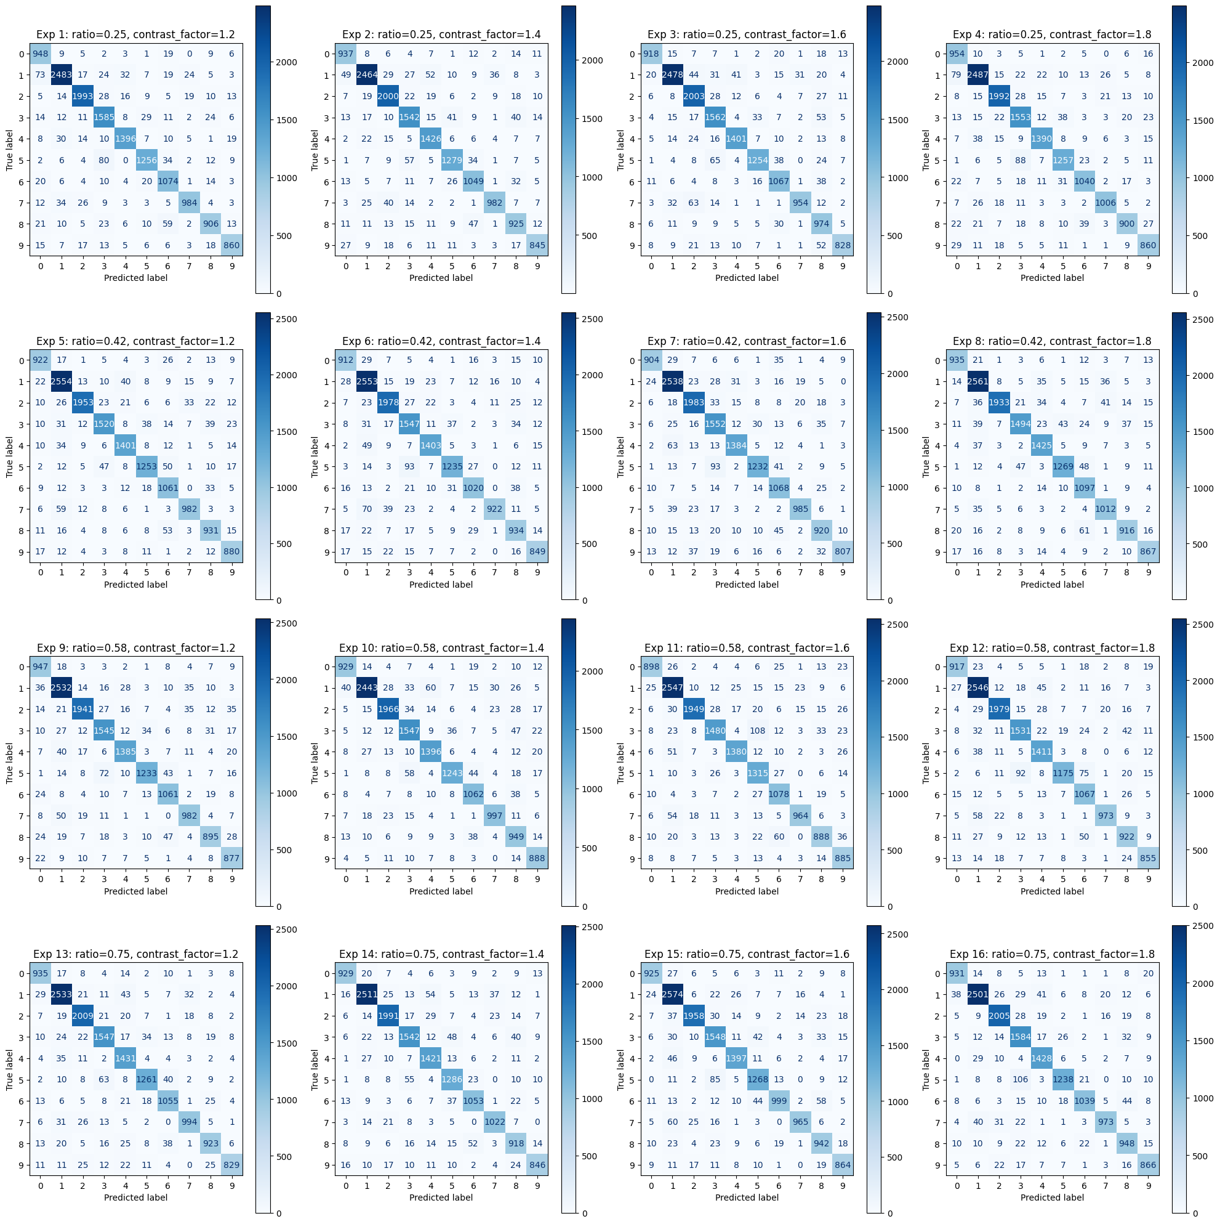
3. Experiments / Experiment Set 3: Augmentation Parameters
Subset 3-2: AspRatios & Contrast
Confusion Matrices:
No obvious visual difference.
All experiments gives a clear counter-diagonal line.
cf=1.2
cf=1.4
cf=1.6
cf=1.8
ratio=0.25
ratio=0.42
ratio=0.58
ratio=0.75

Slide 34
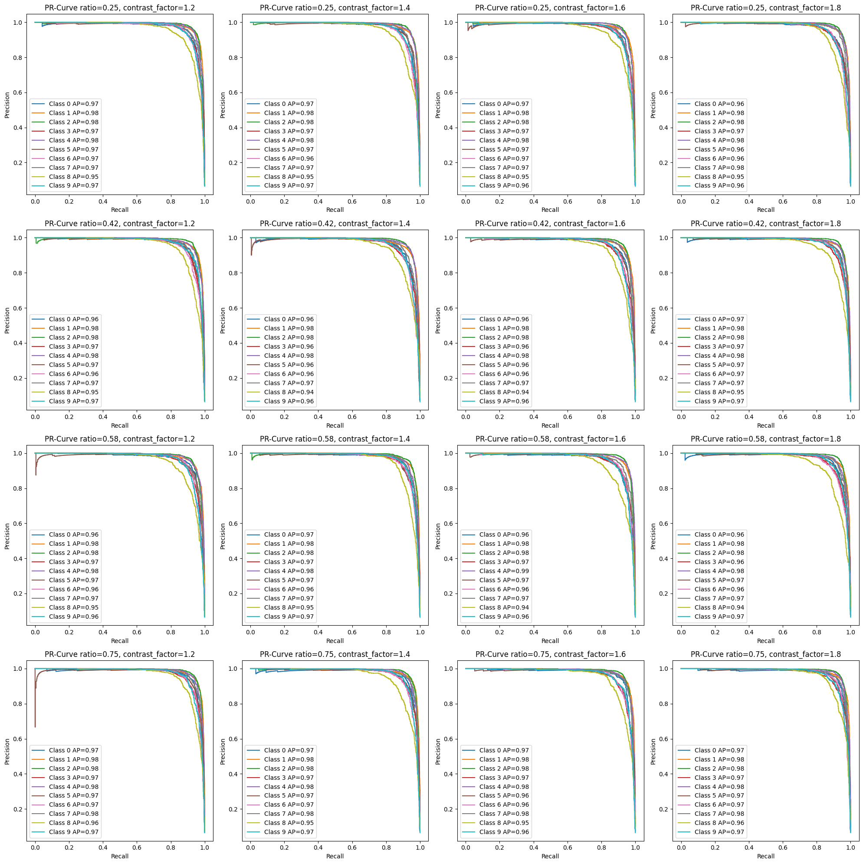
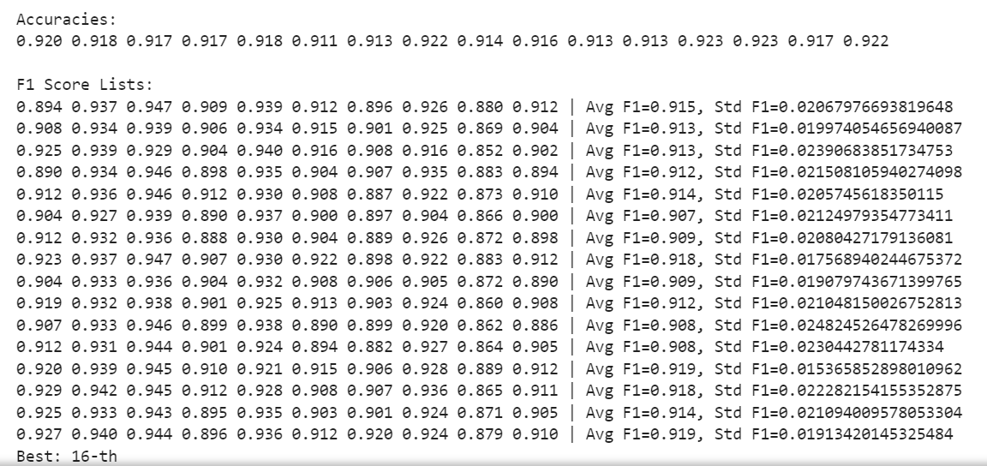
3. Experiments / Experiment Set 3: Augmentation Parameters
Subset 3-2: AspRatios & Contrast
Precision-Recall Curves
No obvious visual difference.
All AP around 0.95.
Evaluation Metrics
13-th give the best ,cosistent with epoch-loss curves. Having the best accuracy of 0.923 and the best Avg F1 score of 0.919 (not the only one).
All sets are similar.
cf=1.2
cf=1.4
cf=1.6
cf=1.8
ratio=0.25
ratio=0.42
ratio=0.58
ratio=0.75
Notes:
All has good grades under the evaluation metrics.

Slide 35
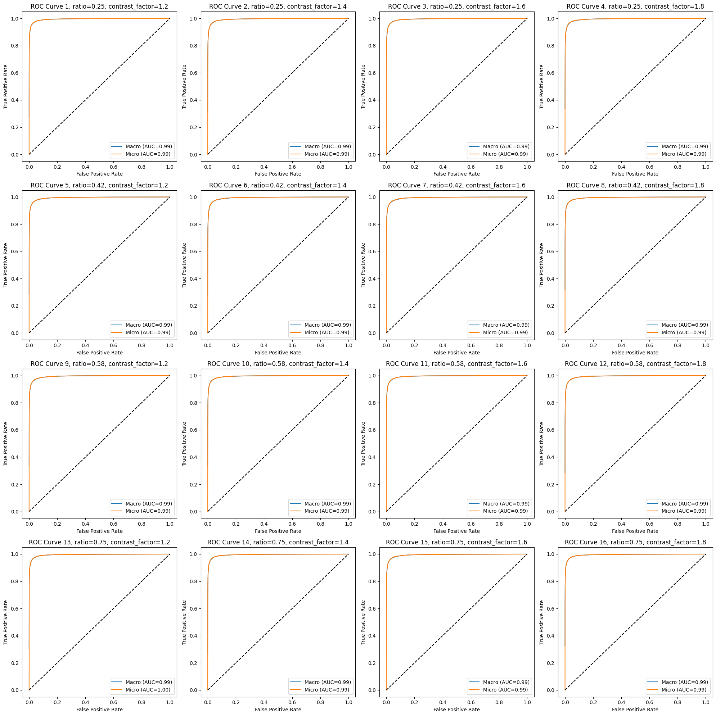
3. Experiments / Experiment Set 3: Augmentation Parameters
Subset 3-2: AspRatios & Contrast
Macro & Micro ROC Curves:
No obvious visual difference.
All has a macro & micro ROC-AUC of around 0.99.
cf=1.2
cf=1.4
cf=1.6
cf=1.8
ratio=0.25
ratio=0.42
ratio=0.58
ratio=0.75

Slide 36
3. Experiments / Experiment Set 4: Extra: NN Structures
Parameters
Optimizer: Adam
Epoch: Determined by early-stopping mechanism.
LR: 1e-3
Batch Size: 128
Angle: 45
Crop: 0.6
Ratio: 0.75
Contrast Factor: 1.8
Loss Function: Cross Entropy Loss
NN Structure: [SmallVGG, LeNet-5, 2012AlexNet, 2014GoogLeNet]
Activation Function: [ReLU, ELU, LeakyReLU, SiLU]

Slide 37
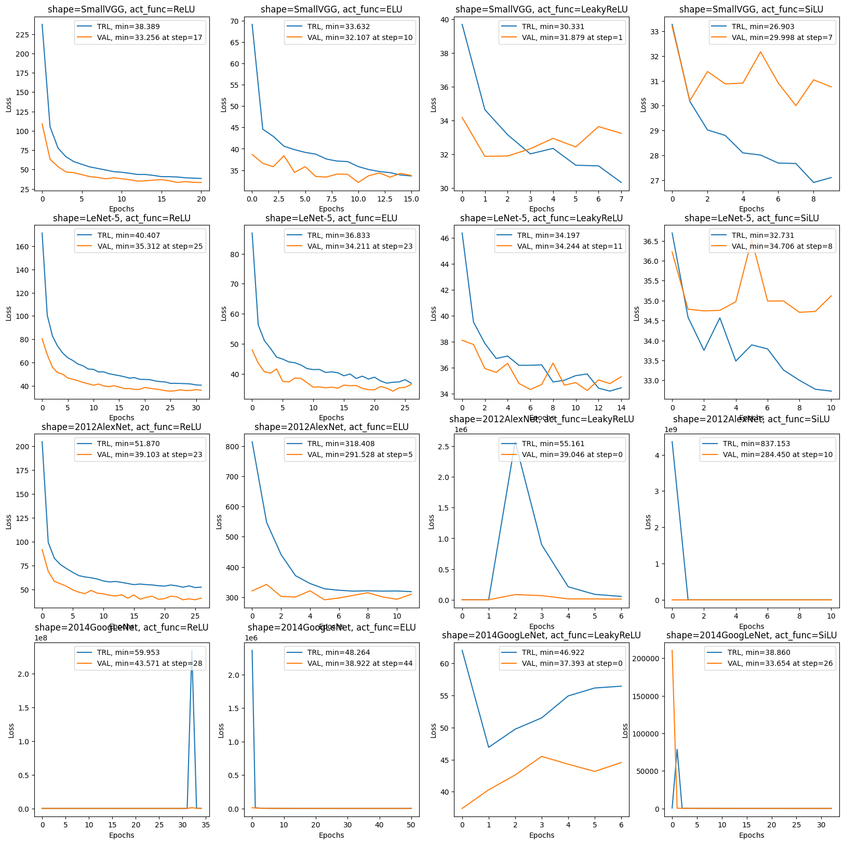
3. Experiments / Experiment Set 4: Extra: NN Structures
Epoch-Loss Curves
Training process of multiple models varies.
ReLU
ELU
LeakyELU
SiLU
SmallVGG
LeNet-5
2012AlexNet
2014GoogLeNet
Notes:
Lastly, as an extra experiment, we would like to test out some of the popular model structures together with the activation functions.

Slide 38
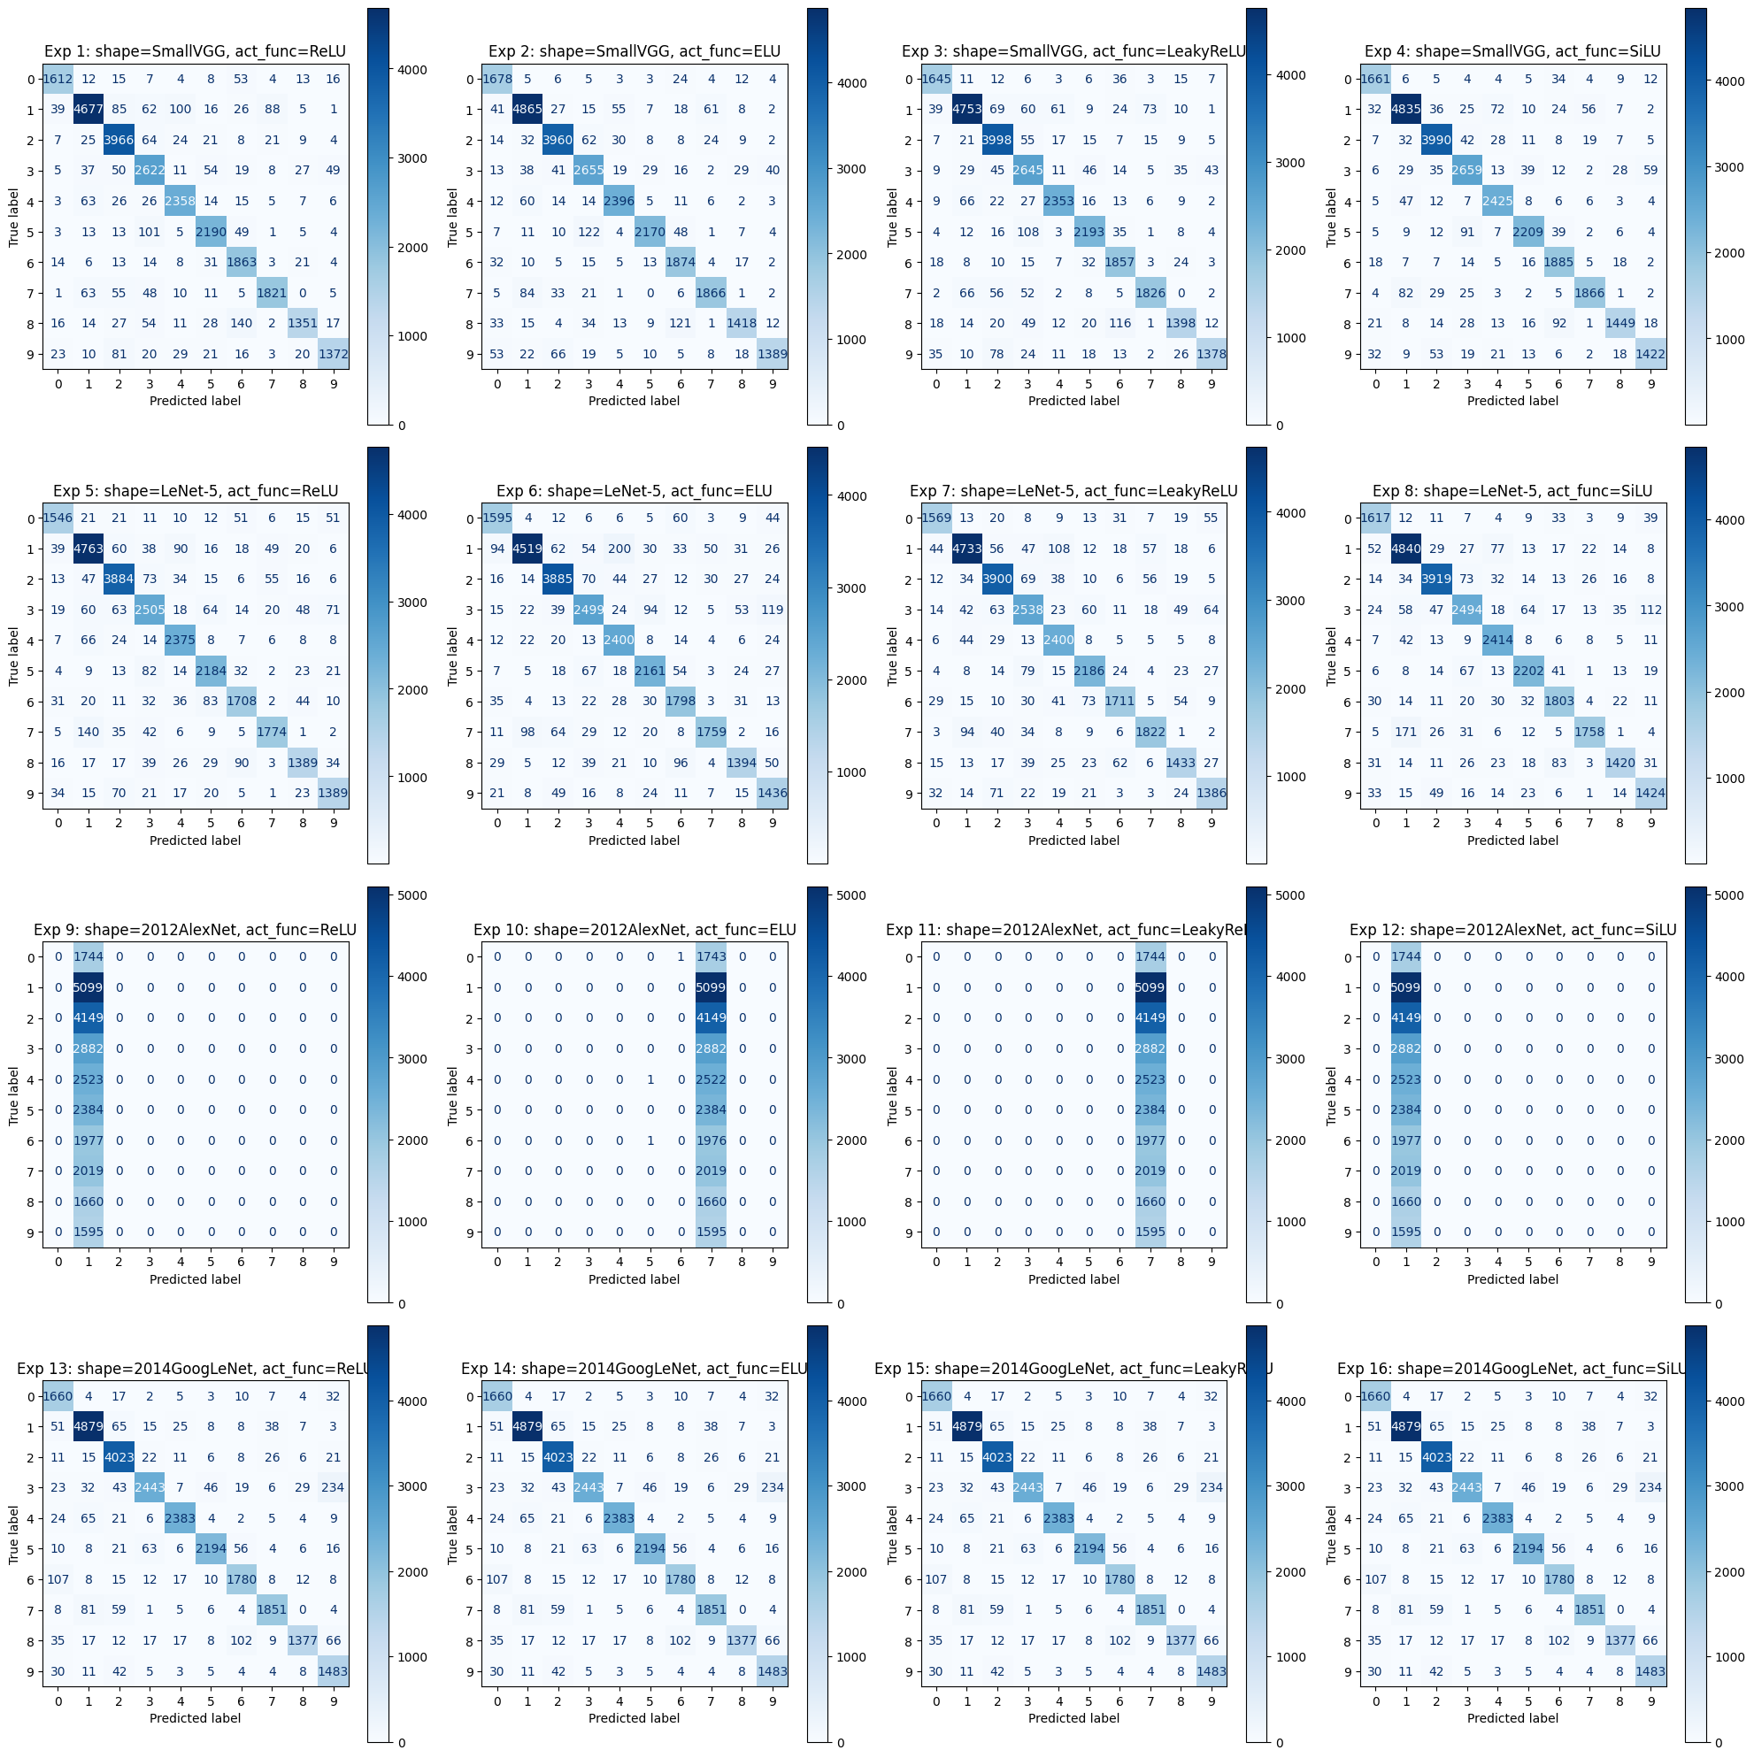
3. Experiments / Experiment Set 4: Extra: NN Structures
Confusion Matrices
All models except for AlexNet gives a clear counter-diagonal line.
AlexNet requires large kernels, but we used small ones of 5x5 and 3x3.
Activation function doesn’t affect much.
ReLU
ELU
LeakyELU
SiLU
SmallVGG
LeNet-5
2012AlexNet
2014GoogLeNet
Notes:
Except for AlexNet, all models performed good, and activation function did not change much.

Slide 39
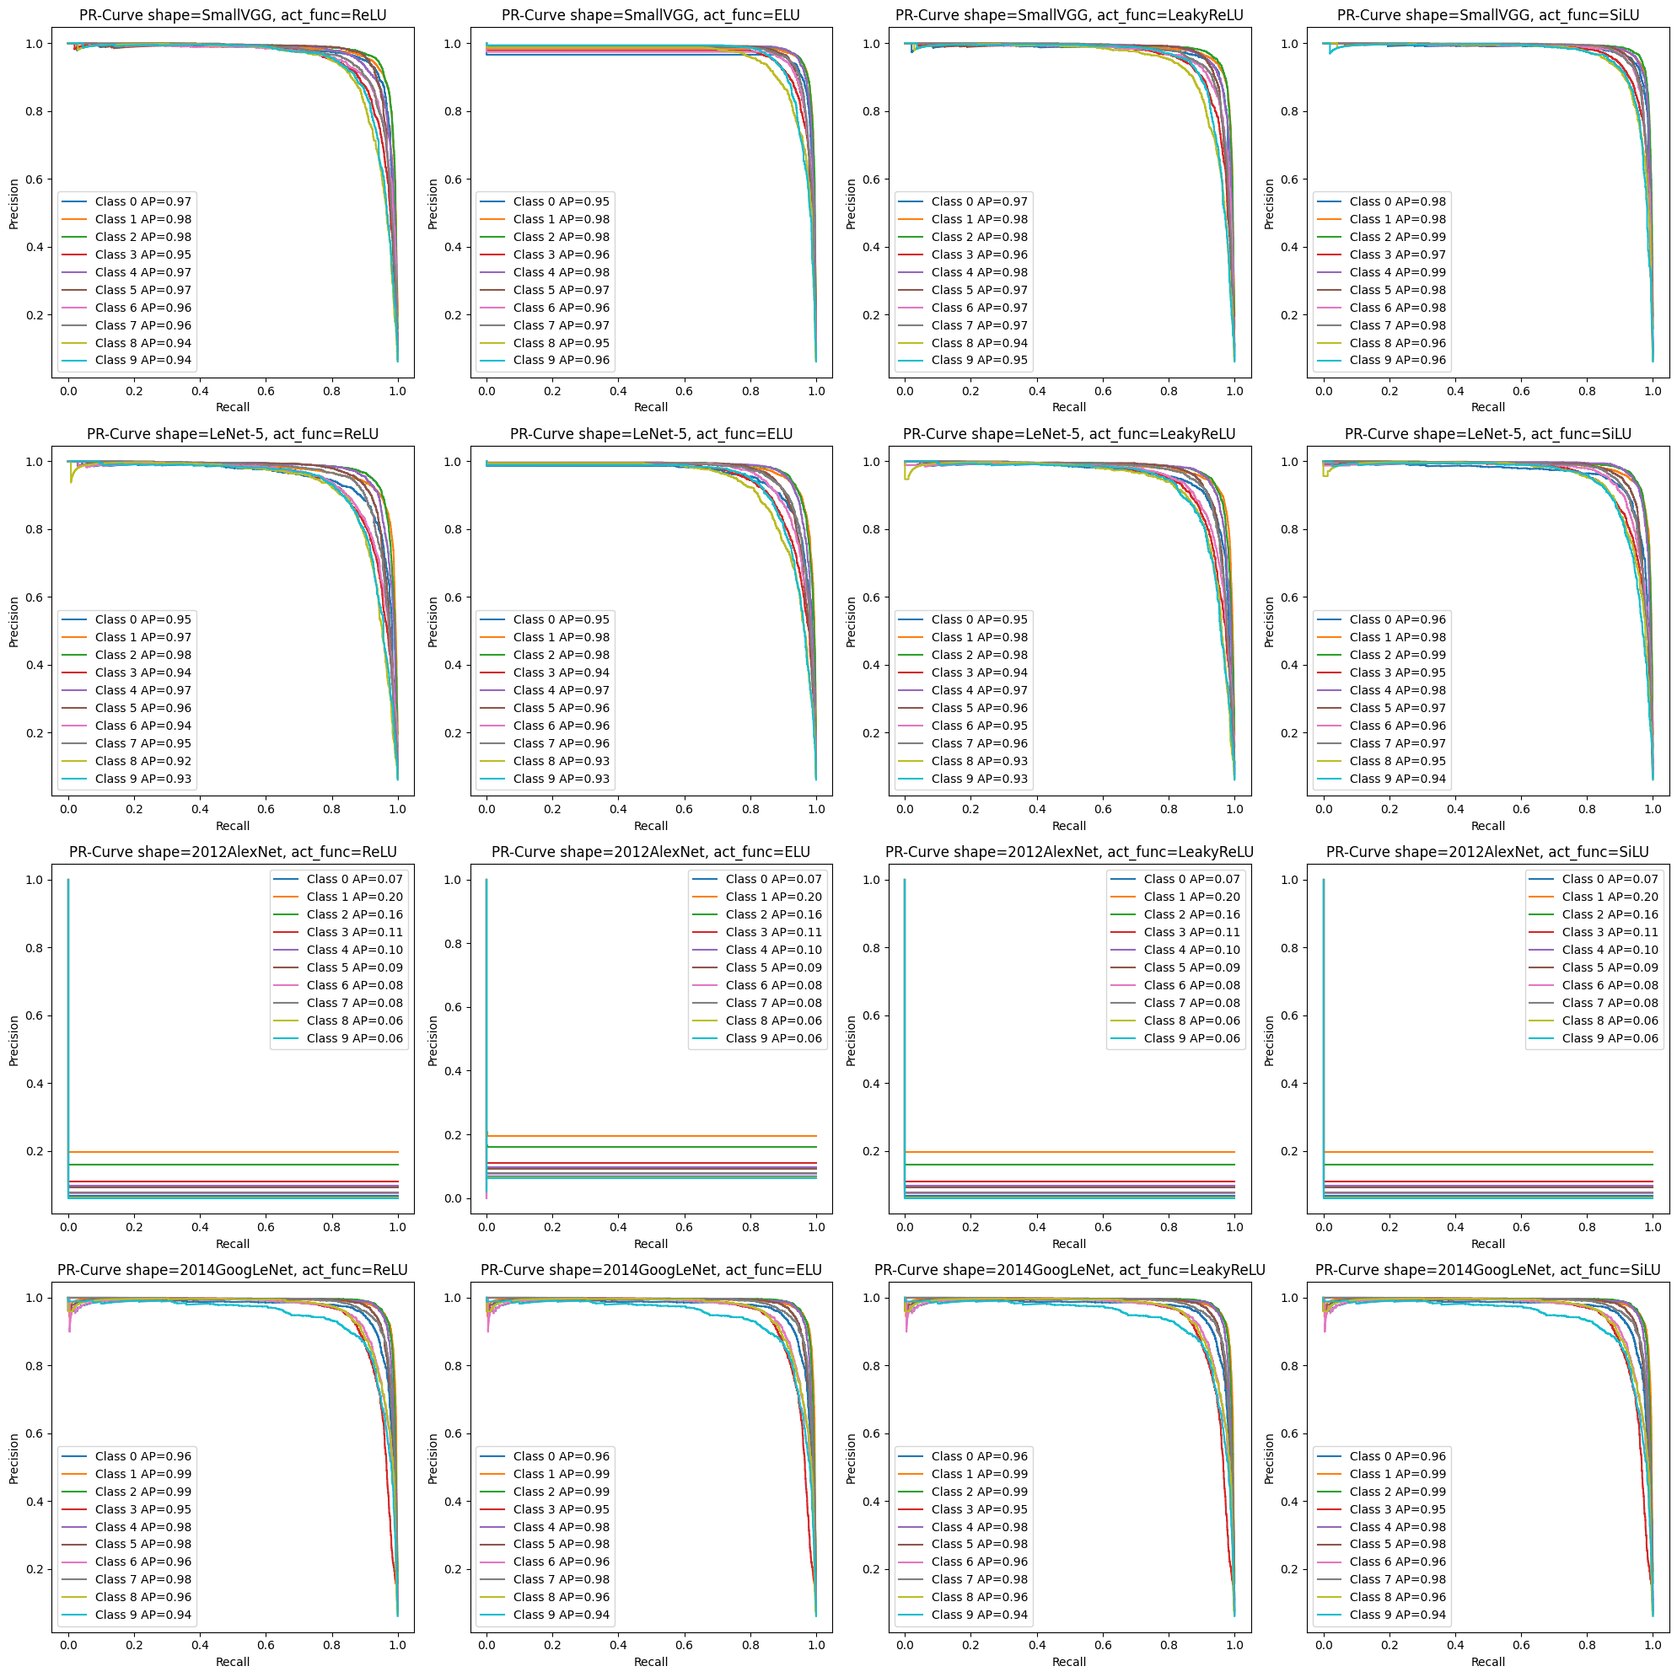
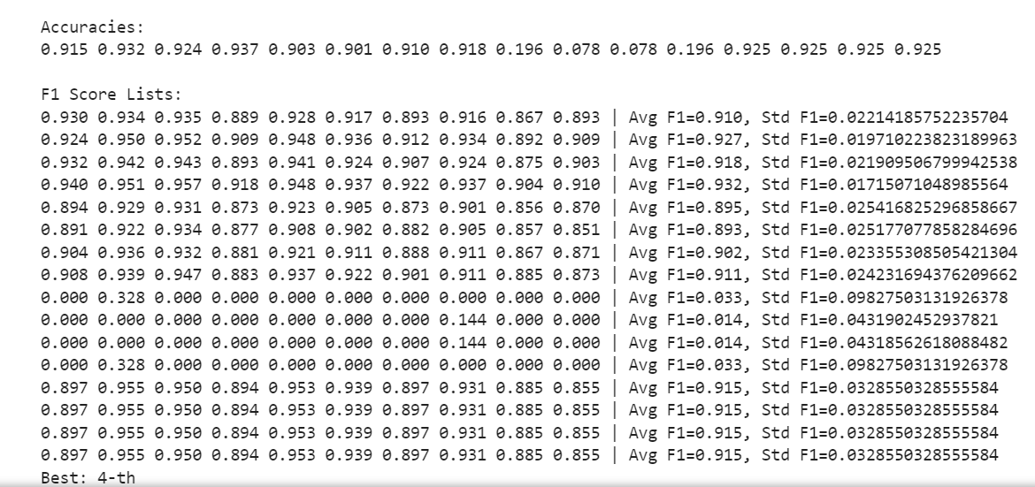
3. Experiments / Experiment Set 4: Extra: NN Structures
Precision-Recall Curve
Except for AlexNet, no big visual difference.
SiLU performs slightly better on SmallVGG.
Evaluation Metrics
All similar, accuracies around 0.91 and avg F1 around 0.90, except for AlexNet.
ReLU
ELU
LeakyELU
SiLU
SmallVGG
LeNet-5
2012AlexNet
2014GoogLeNet
Notes:
However, SiLU performed slightly better than others on SmallVGG.
Evaluation metrics gave us similar great scores of the models, except for the AlexNet.

Slide 40
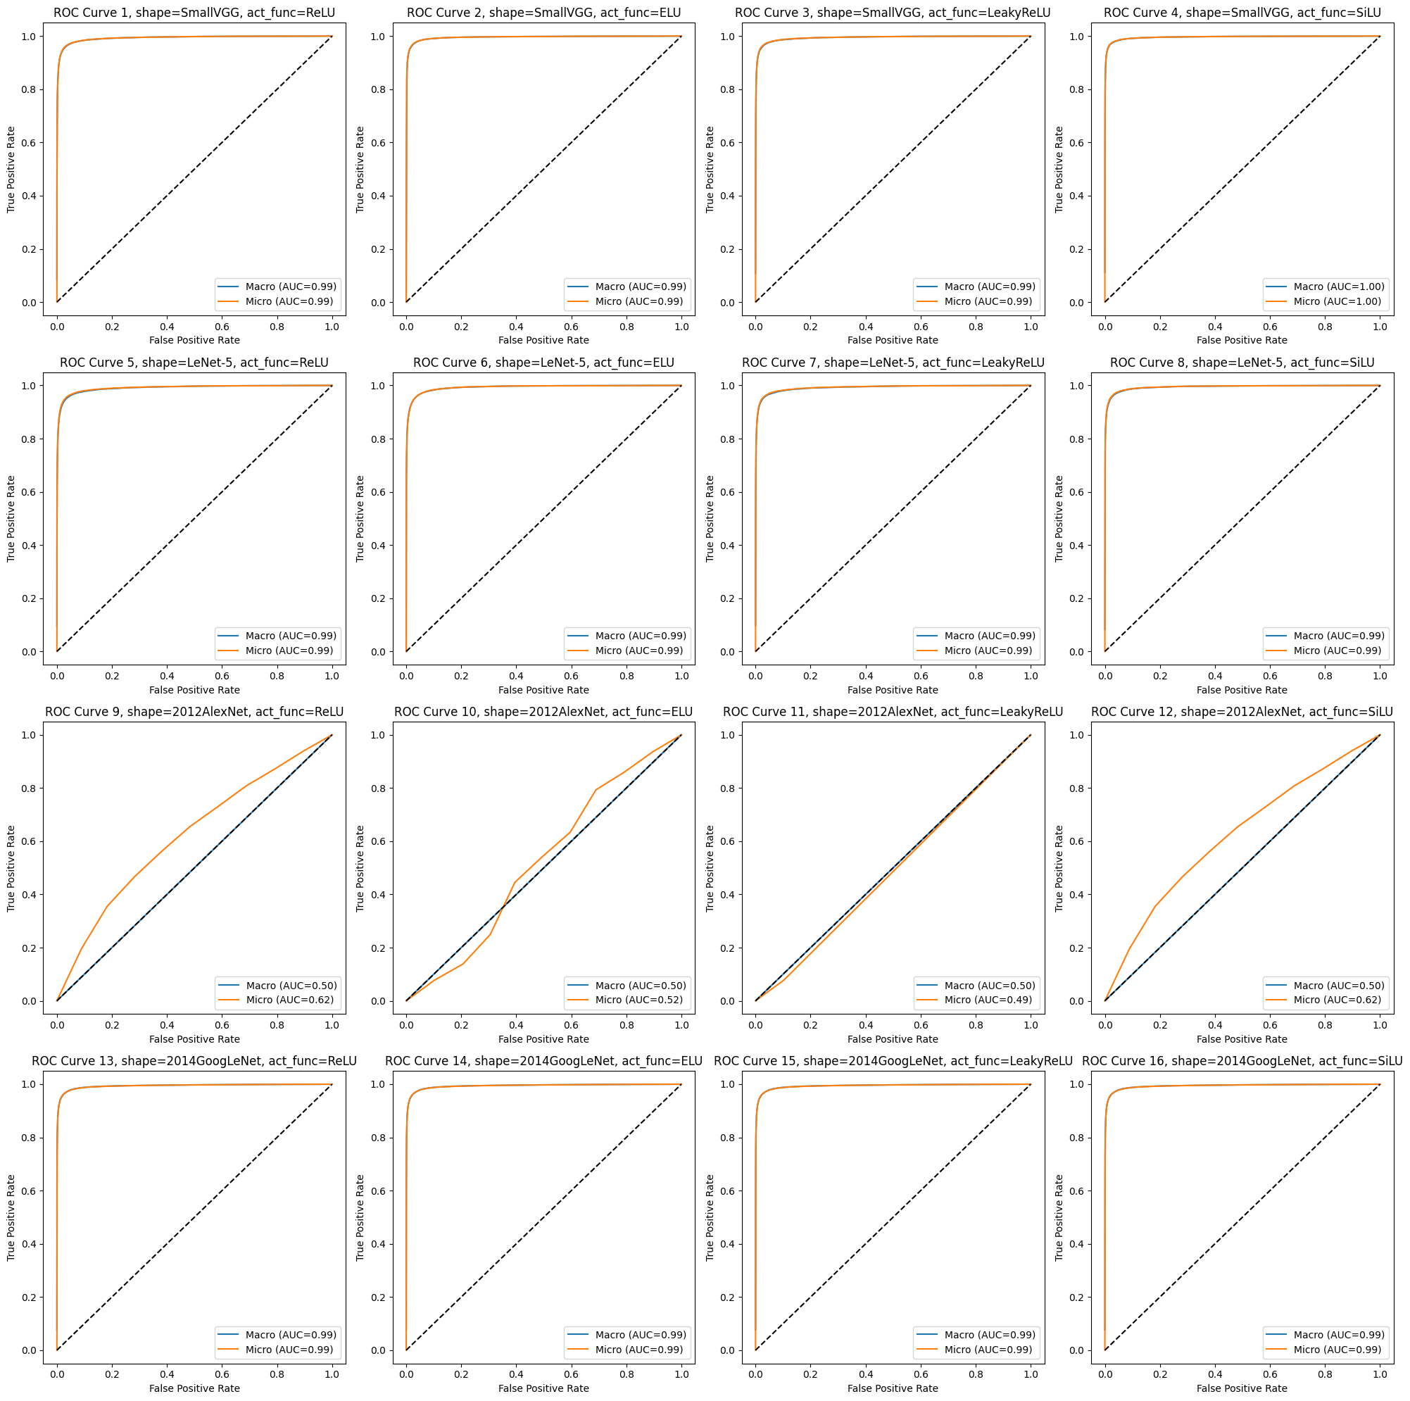
3. Experiments / Experiment Set 4: Extra: NN Structures
Macro & Micro ROC Curve
No visual difference except for AlexNet.
Other has both macro & micro ROC-AUC of around 0.99, while AlexNet having both around 0.5~0.6. The Macro ROC curve overlapped with the random split line.
For AlexNet, macro & micro differs.
Macro very low: Bad on individual class.
Higher Micro: Better (?) as a group.
Difference of Macro and Micro is large: There are imbalances on classes.
ReLU
ELU
LeakyELU
SiLU
SmallVGG
LeNet-5
2012AlexNet
2014GoogLeNet
Notes:
ROC curves suggested that AlexNet performed radically differently on different labels, with ROC-AUC scores of around 0.5~0.6.

Slide 41
3. Experiments / Conclusion
Summary of Discovery
RMSprop family, especially Adam, performs the best with the simplest initialization.
While epoch and LR is key to the training performance, batch size has little effect.
Proper image augmentation brings better minimum validation loss due to the increase of data variety.
For many model structures, our candidate activation function doesn’t effect the training & application performance much.
Aspects to improve
Decrease the allowance of randomness.
Contrast factor brings high variance in training data’s mean & std.
Calculation of mean & std directly may cause insufficiency.
Add more normalization factors.
More detailed search, i.e., more combinations.
More caniddates
More combinations

Slide 42
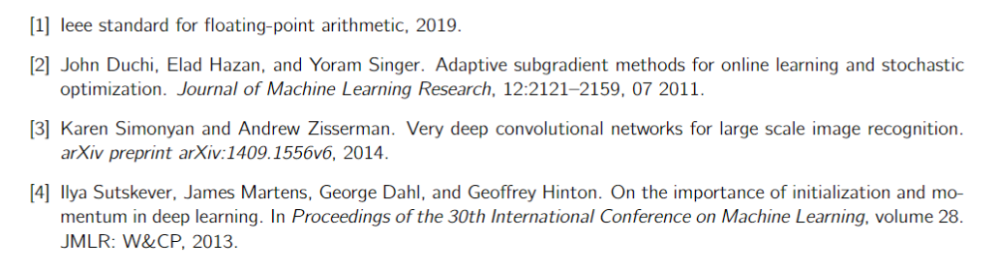
3. Experiments / References

Slide 43
Thank You!
Huang Yanzhen, DC126732 (Presenter)
Mai Jiajun, DC127853

